Slide 1




Continuing Bonds: Creative Dissemination
Teaching Materials

Slide 2
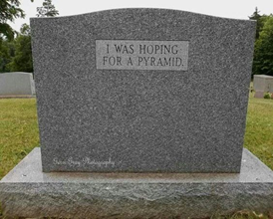
Workshop 1: Inspiration
Let’s talk of the dead…
Notes:
This workshop should take 1.5 - 2 hours to complete.
The exercises are optional and the exercises used will impact the length of the workshop.
Workshop numbers will also impact on timings.

Slide 3
Timetable
5 mins Welcome and keeping it safe
10 mins Let’s talk of the dead
15 mins Keeping the dead close and difficulty with objects. (With a 5 min exercise.)
15 mins Archaeological objects – for inspiration
-Break-
10 mins What Object would you have as your legacy? (Exercise)
10 mins Objects and loss. (Exercise)
5 mins Drawing to a close and the next workshop
5 mins Art Exercise
Notes:
This is the timetable for Workshop 1, Inspiration. The timetable above gives suggested timings but you may wish to change these depending on the time you have available.
You will find accompanying documents in the Guidance Notes.

Slide 4
Welcome
Today's Focus
-Meeting fellow writers
-To be inspired! (Introduction to archaeological and contemporary materials)
-To start creating your piece
Ultimate aims
-3 workshops (‘Inspiration’, ‘Deepening Connection’, ‘Editing/finalizing’ – more space for working on your piece in latter two)
-Widening the boundaries on talking about death, dying, bereavement and grief
Notes:
The aim of the ‘Inspiration’ workshop is to introduce individuals to archaeological and contemporary materials which showcase different aspects of death, dying, bereavement and grief. This first workshop is an opportunity for writers (including amateurs – no writing experience is needed) to meet each other and start developing working relationships, to be inspired by the materials they are introduced to and to engage in writing exercises which may feed into a final creative piece.
Often, in the Western world, such subjects are felt ‘taboo’ which can lead to individuals feeling their grief- or the ways in which they remember deceased loved ones- are not ‘normal’. It can also lead to problems around death such as individuals not clearly informing loved ones’ what their wishes are for their body or funeral after death. At a societal level, not talking about death as a normal part of life can lead to death being ‘professionalised’ with individuals being unsure about what actually happens at end of life and what their rights and options are.
Details of the original ‘Continuing Bonds’ project and an anthology created through the ‘Creative Dissemination’ project can be accessed at https://continuingbonds.live/.

Slide 5
Let's keep it safe
Creative writing 'death café': not therapy... (importance of information packs)
'Rules'
Non-judgmental, supportive atmosphere – giving everyone space to speak if they wish to
Confidentiality
Constructive feedback - what you liked, what you would like to see more of, framing points positively
Looking after yourself
Sources of support on information sheet in your packs
Take a break whenever you need
Allow yourself to 'hold back' if you need to
Notes:
Although the materials might spark personal thoughts or memories, the workshop (as is true for all three workshops) is not intended to be ‘therapy’. We would encourage participants to look after themselves in terms of allowing themselves to ‘hold back’ emotionally if this feels needed and to use the ‘Sources of Support’ available in the Guidance Booklet.
To create a safe space for attendees, facilitators can create ‘rules’ for the workshop. It is important the space is non-judgemental and supportive, that personal stories/experiences shared in the workshop are kept confidential, and that feedback on creative work is given positively. It can be helpful to frame feedback in terms of what individuals liked about someone’s work and what they would like to see more of. There is a handout on ‘Giving Helpful Feedback’ in the Guidance Booklet.

Slide 6
Where did the inspiration materials come from?
Archaeological sources
Contemporary experiences of death, dying, bereavement and grief.
  Quotes taken from project workshops run by the Continuing Bonds project
Notes:
In this workshop, individuals will be introduced to materials which we hope will inspire creative work. These materials are both archaeological and contemporary, the quotes which showcase the latter being taken from workshops run by the Continuing Bonds: Creative Dissemination project.

Slide 7
Let's talk of the dead... (1)
Different researchers, authors, organizations say we don’t talk enough about death, dying, bereavement and grief.
“[When I was a] student there [was] an older lady who [told me], ‘in the 1940s or 50s grandma used to die in the parlour and you would all see the dead body. We talked about death but we didn’t talk about sex. Whereas,’ she said, ‘I notice with your generation [you] are very happy talking about sex but [you] don’t talk about death. And, is that because [you] don’t see it?’.”
Notes:
Many individuals and organisations say we do not talk enough about death, dying, bereavement and grief.
This quote comes from a health and care professional who took part in a research workshop.

Slide 8
Let’s talk of the dead… (2)
Not talking about death can lead to difficulties, both for the dying and families/friends
“My ex-girlfriend, her father got cancer and he knew he was going to die. It was terminal. It wasn’t very long, about 8 months, but he had time to sort things out [and] he didn’t. Then it was the responsibility of his daughter, who was my partner at the time, and it was devastating for her. This man should have sorted things out. Instead of grieving for her Dad [my girlfriend] was having to organise everything.”
Notes:
It is important for individuals to feel able to talk about death if they need or wish to. This quote explains how not talking about death can lead to difficulties, which can be for the dying and for the bereaved.
Embedded within this account is the sense that there is a ‘right’ thing to do – for a person to ‘sort’ their affairs out if they know they are dying and have time enough to do so. Interestingly, this account contrasts with another person’s account, who passionately described not forcing a person into talking about their own death if they are not ready. It seems there are two ‘right’ things to do which do not sit neatly together. This is an example of the politics of death, which is explored later in the teaching slides for workshop 2 (Deepening Connection).

Slide 9
Let's talk of the dead... (3)
The Continuing Bonds theory.
    Klass, Silverman and Nickman (1996)
“when your loved one dies grief isn’t about working through a linear process that ends with ‘acceptance’ or a ‘new life’, where you have moved on or compartmentalized your loved one’s memory.
Rather, when a loved one dies you slowly find ways to adjust and redefine your relationship with that person, allowing for a continued bond with that person that will endure, in different ways and to varying degrees, throughout your life”
http://www.whatsyourgrief.com/continuing-bonds-shifting-the-grief-paradigm/
Notes:
In the modern Western world we often think about grief as progressing through a series of stages towards a place of acceptance, as suggested by Kubler-Ross in her 1969 book On Death and Dying. However, we know that individuals do not always experience grief in these ways and instead, the Continuing Bonds model as proposed by Klass, Silverman and Nickman (1996), might be more accurate.
Certainly, archaeologists have seen individuals to maintain their bonds with the dead and keep the dead close across time and across cultures.

Slide 10
We keep the dead closer than we might think (1)
Because we don’t talk about death that much, we’re not always aware of what other people ‘do’ with their loved ones. Lots of people like to keep the dead close.
“My mum had a Retriever. He died and was cremated. He was quite a big dog and it’s amazing how heavy [his ashes are]. You think it’s going to be really light and he was heavy in death as well as life! But that follows her everywhere. She has moved house two or three times now and he still lives under the bed. At some point in the future something will happen to her and [] I am going to have to ask her [] ‘do you want to be cremated? Do you want the dog with you? Do you want us to keep it separately?’
“I was in a friend’s kitchen a couple of weeks ago and there was a 1950s biscuit tin. I said, ‘oh it’s nice’ and they said, ‘it’s my share of my dad’. I said, ‘have your brothers both got a tin’ and they said, ‘yes’. So, the three of them all had a tin with a third of Dad.”
Notes:
As we rarely talk about death in ‘normal’ conversation in Western society, we are often unaware of what other people ‘do’ with their loved ones. As a result, we are unsure about what is normal. If we have not encountered keeping the dead close physically this might evoke feelings of disgust or revulsion, however, keeping the dead close is normal and has been for many years.
The quotes here exemplify people in modern day keeping the dead close in the form of ashes.

Slide 11
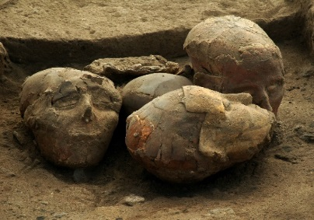
We keep the dead closer than we might think (2)
Archaeologists explore communities who were literally closer to their dead
    Plastered skulls
    Intimacy of care
    Longevity of presence among the living
    Continuing bonds...
Tell Aswad, Syria (c. 8500BC) © Danielle Stordeur
Notes:
Keeping ashes close is something we do in modern-day life and is something we have done for years.
This example (the Plastered Skulls from the Neolithic Middle East) demonstrates an example where the dead were kept tangibly close. Some people were buried beneath the floor of the house after death. The skulls of some of these individuals were then excavated by the inhabitants and a face of plaster was re-created over the dry bone. They were then kept within the household or courtyards. The skulls show evidence of breakage and repair suggesting that they were handled and cared for.

Slide 12
We’re never quite ‘done’ with the dead
Archaeology teaches us we’re never quite ‘done’ with the dead
    No ‘time limit’ on loss or grief
    The dead place ‘debts’ upon us. Not just emotional but the ‘stuff’ of their lives
        Grave goods vs heirlooms
        Bequests
        The ‘left behind’ detritus we cannot quite get rid of. ‘The burden of things’.
“My mum died very suddenly. [] Just before she died she’d bought a big tub of Horlicks which she gave to me for some reason. [] I could not throw this away. It was in the cupboard for five years! And it was solid. But because she’d bought it, it became like an artefact.”
Line drawing by Agnes Mortimer of a coral and bronze hair pin excavated by her father, John Mortimer, from an Iron Age burial in the Yorkshire Wolds. 1911.
Notes:
Throughout time and (geographical space), we see that individuals have remembered their dead for years and across generations. Thus, archaeology teaches us we are never quite done with the dead. This shows us how there is no ‘time-limit’ on loss or grief. This concept – that there is no time limit on loss or grief – is different to many of the messages we get in modern day society which affords us three days bereavement leave and often expects us to move towards a place of acceptance or ‘closure’.
Objects are often powerful evokers of memory and help us retain relationships with the dead. Many people retain objects which belonged to the dead or heirlooms. There are also objects placed/buried with the dead which archaeologists find during excavations such as … enter the hairpin info.
The dead place debts upon us with the ‘stuff’ of their lives which they leave behind. This stuff can sometime be problematic or ‘out of the ordinary’, as this quote shows us. For many these objects can also be a comfort.

Slide 13
Why do we have ‘difficult stuff’ and trouble with keeping or throwing things away? (1)
The sense that they are not ‘ours’?
“Dead people’s flowers, what happens? They get put in the bin. That is a very symbolic thing, ‘when do I put them in the bin? I don’t want to put them in the bin. They’re his’.”
Because it symbolises a change? Maybe an act of ‘moving on’. An act of ‘forgetting’?
How we treat objects can change over time – e.g. clothing in the aftermath of the death can be 'needful' and then later, too painful (hidden away, untouched)
Notes:
There may be multiple reasons why the objects we are left with are difficult.
One reason why objects which belonged to- or are associated with- the dead are ‘difficult’, is because they are perishable and therefore require a quick decision to be made. Rather than a person taking their time with an object, they are forced to take a decision (e.g. throwing an object away) which doesn’t feel right in terms of where they are with their grief.
This quote depicts the dilemma that flowers which belonged to the dead pose to the living. Perhaps they are difficult to throw away because they do not feel they ‘belong’ to the living (and therefore it is not their right to make the choice), or because they symbolise an act of ‘moving on’ which does not feel right.
How we feel about- and treat- objects can change over time. For example, a person may initially need to wear an item of clothing which belonged to the deceased for comfort, which later becomes too painful to wear. Or, vice versa: an item of clothing which feels too painful to wear initially becomes a way of the individual continuing their bond with the deceased and incorporating them into their daily life later on.

Slide 14
Why do we have ‘difficult stuff’ and trouble with keeping or throwing things away? (2)
Some objects are intensely connected with the person
“Well, my dad, I remember him as a kid – very smart, very well dressed, polished shoes and stuff. When he got older, bless him, he was stooped. He had real problems. His feet swelled up and he had this pair of shoes, [] these dreadful misshapen shoes, and I couldn’t throw [them] away. One day they were sitting in my bedroom as it’s as if I could hear his voice in my head. ‘Why are you doing this? Do you think that’s how I want you to remember me? Get rid of them’. So I got rid of them. I think you have to hold onto things until it’s time to release them.”
Exercise: Have you had any objects (which represented the deceased) you’ve not been able to throw away which are meaningful or vital to you? (You don’t have to share)
Notes:
Some of the objects we are left with are intensely connected with the person, as is showcased in this quote.
[Optional] Exercise. 5 minutes:
Have attendees had any objects which represented the deceased and which are meaningful to them?
(It is important individuals have the option not to share and to keep their reflection personal).

Slide 15
Objects for Inspiration…
Notes:
The following 5 slides showcase objects which can inspire creative writing and poetic pieces.
Feel free to jot down some initial thoughts and reactions to the objects.

Slide 16
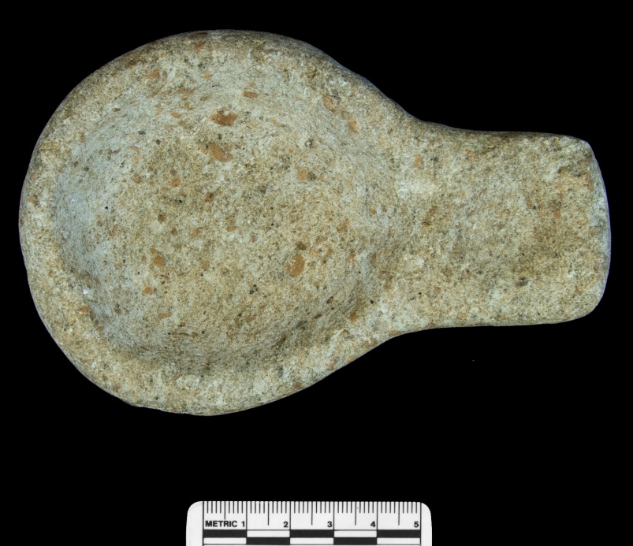
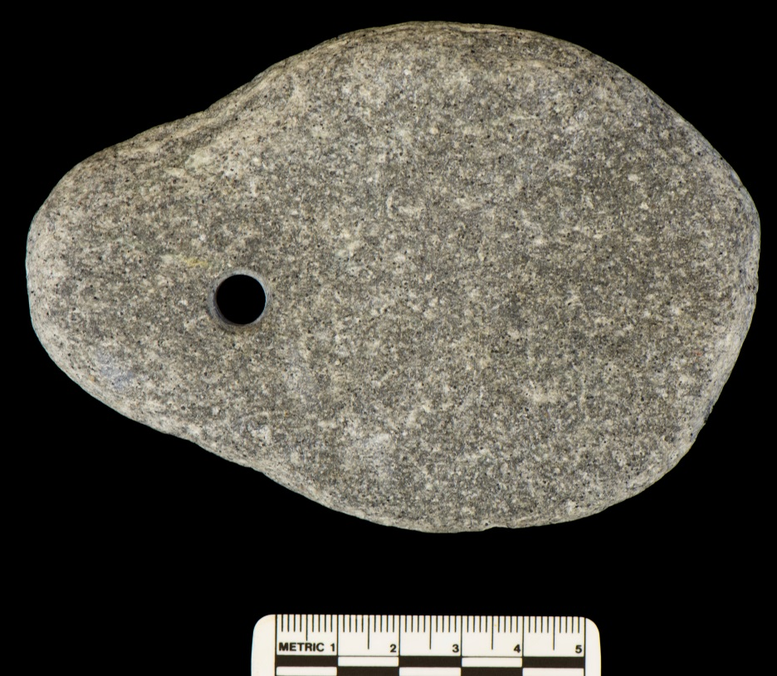
Oil lamp and loom weight
Loom weight (below): Loom weights are usually circular stone or clay objects, with a hole at the centre for weighing down the warp threads when weaving. When such objects are found in graves they are thought to relate to occupations or roles in life.
Oil lamp (above): Oil lamps are sometimes found in graves and may have represented a concept of bringing light to the afterlife, or may relate to burning to mask aromas or for inhalation.

Slide 17
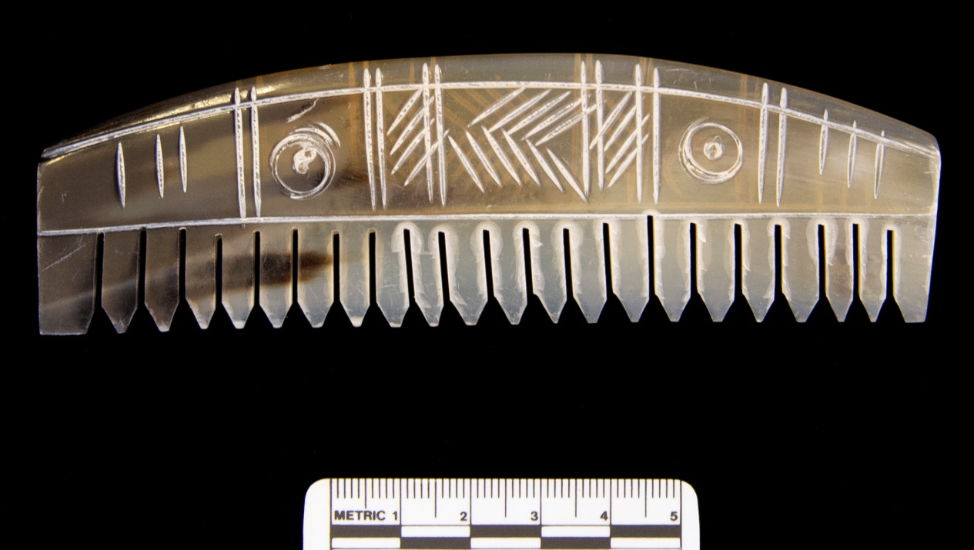
Comb
Combs were found in many Anglo-Saxon burials, as a highly personal and beautifully crafted object which also spoke of care for the dead: making them look their best for the afterlife. It was also a last act of care and tenderness that the living could provide for the dead.

Slide 18
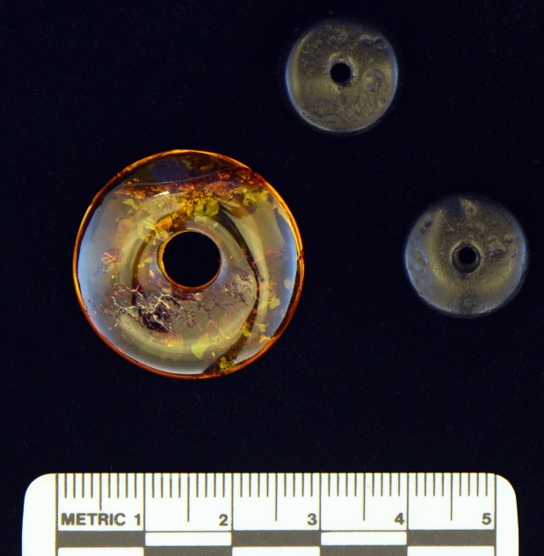
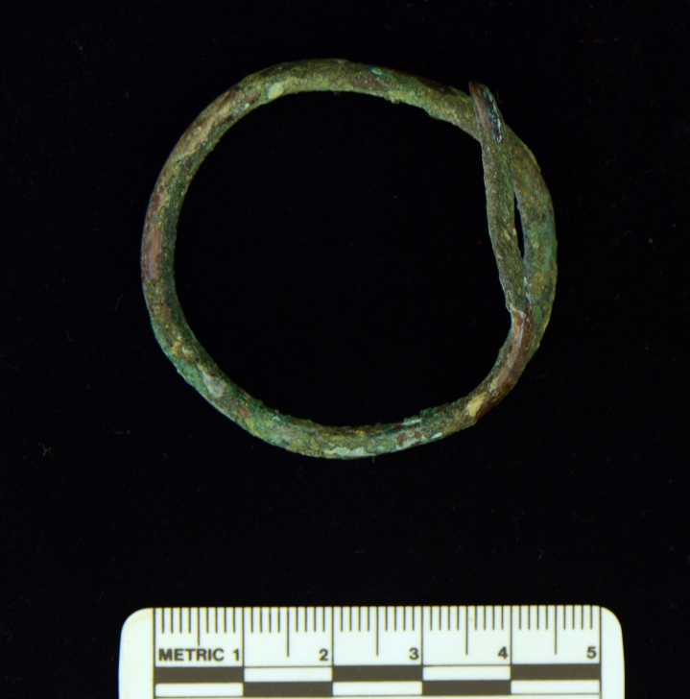
Amber Beads and Roman Bracelet
Bronze Romano-British child’s bracelet. Found in Colchester, England. C.100 AD.
Amber beads are rare but were found in Bronze Age and Iron Age burials, sometimes as a beautiful necklace or a single bead. Amber came from afar and it seemed to shine with warmth and power, providing something beautiful to the dead whilst also showing off their connections with foreign places and people.

Slide 19
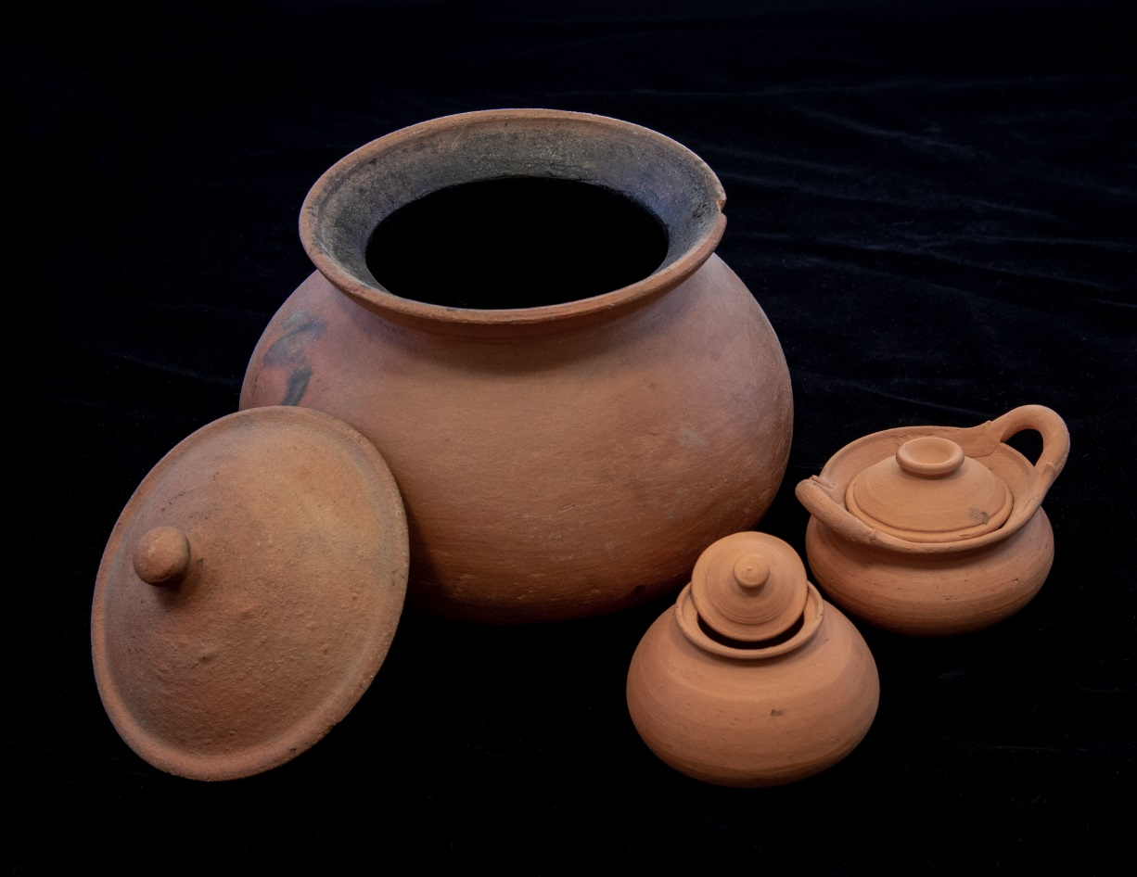
Grave Pots
Pots are the most common grave good we find. Sometimes they contain food, sometimes drink. They may be well-made, or newly fired, beautifully decorated or quite plain. They can be a container for the ashes of the dead or a vessel for the afterlife. These three replica pots - one large and two small - are copied from Khok Phanom Di, Thailand(2,000–1,500BC): the larger one for an adult, the miniature versions for a child; both given a vessel that fits their identity and prepares them for the afterlife.

Slide 20
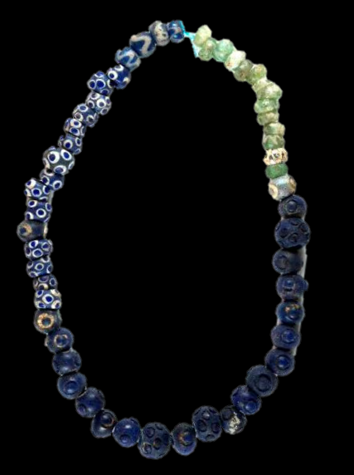
Heirlooms
This necklace is from the Queen’s Barrow, Arras, East Yorkshire (c. 400-2– BC). It is made of about 100 glass beads, of which 67 survive.
The beads comprise five different types, not often seen together. They also display different degrees of wear, suggesting that some are new (perhaps made for the grave) and some are old.

Slide 21
Break

Slide 22
Exercise: What object would you have as your legacy?
“My dad, he is currently [] at my mum’s house. He is dead and he is cremated. He sits in a green pot and he lives on the window sill because he wanted to be in the light. That was really important to him, to be in the light. [] It was really important to him he wasn’t in the dark.”
EXERCISE 1. Free writing.
    An exercise which can provide a starting place for a piece, help develop ideas, or move us past writer’s block
    Whatever comes into your mind. Don’t censor yourself.
    5 minutes
    “The object I would have as my legacy is…”
Notes:
The objects showcased and the quote above embody some of the legacy which individuals leave behind. Sometimes this is purposeful – we chose to bequeath objects such as jewellery to particular loved ones or ask that their ashes are kept ‘in the light’. Sometimes we have less control over this and it is the objects others choose for us (e.g. the jewellery we are buried in) or which society chooses for us (e.g. the pots buried next to us) which become our legacy many years on.
[Optional] Exercise. 10 minutes:
This exercise involves free-writing for five minutes, starting with the phrase, ‘The object I would have as my legacy is…’.
Free writing is a method which can provide a starting place for a piece, help a writer develop their ideas or move an individual past writer’s block. The idea is to write whatever comes into a person’s mind without censoring oneself. Writers are advised not to go back and read what they have written during the five minutes and not to worry about correcting spelling or grammar at this point.
Afterwards, individuals may wish to share what they have written.

Slide 23
Exercise: Free writing – objects and loss
Choose an object related to an aspect of bereavement, loss of grief
    Ashes of the retriever
    1950s biscuit tin with a ‘third of dad’
    Plastered skulls
    Horlicks
    Flowers
    Shoes
    Green pot
    Pottery vessel , beads, oil lamp, roman bracelet, loom weight…
    Something personal to you
Free writing
    Remember: Whatever comes into your mind. Don’t censor yourself.
    Can write from your own perspective or that of a character.
    5 minutes
    “As I think about the (insert object), I…”
    “As [insert character’s name] thought about the [insert object], s/he…”
Notes:
Throughout the slides so far, we have mentioned or showcased many objects, from a jar of Horlicks, to misshapen shoes to plastered skulls. The following exercise can help individuals to use these objects (or an object of their own choosing) as inspiration. Writers can write with themselves as the narrator (e.g. I remember my mother’s necklace…) or by using a character (e.g. Harry pulled a grey box from under the bed and blew the dust from the lid…).
[Optional] Exercise. 10 minutes:
Free-writing for 5 minutes, using the sentence ‘As I think about the [insert object], I…’ / ‘As [insert character’s name] thought about the [insert object], s/he …’.
Afterwards, individuals may wish to share what they have written.

Slide 24
Drawing to a close…
Let the materials ‘work’ on you and then spend some time gathering your thoughts and ideas (we’ll be doing much more writing next time)
If you want to bring an object from home (or a photo of this), you’re welcome to bring this to next session
Look after yourselves... use the sources of support if need be
Notes:
Between this workshop and the next, attendees are advised to let the materials ‘work’ on them and send time gathering their thoughts. There will be more time set aside for writing in the second- and especially the third- workshops.
If individuals would like to bring an object from home (or a photo of this) to the next workshop as inspiration they are welcome to. Attendees might like to bring objects which remind them of their deceased loved ones or an object which they would like to have as their legacy.
Talking about death and dying can bring up thoughts and emotions which are difficult or unexpected. Remind attendees to look after themselves and to use sources of support if needed. There is an example of a Sources of Support document in the Guidance Booklet. Sources of support will need to be developed specifically for the geographical area workshops are being facilitated in.

Slide 25
Next time
‘Deepening Connection’
Again, the opportunity to engage with the objects and the archaeological case studies
Some basic creative writing/poetry guidance
Time to develop your piece
Feedback buddies ( see ‘Giving Helpful Feedback’)
Notes:
The next workshop is called Deepening Connection. In this workshop, individuals will have the opportunity to engage again with the objects and archaeological case studies. They will be introduced to more archaeological and contemporary inspiration material and will be given some basic creative writing/poetry guidance.
Individuals will have time to start developing their piece/develop their piece further.
We would encourage participants (if they like) to ‘buddy up’ with another writer/poet from this workshop (workshop 1) so that they can swap their pieces and get feedback on these.

Slide 26
Leave us with your thoughts…
Art exercise
    Draw round your hand
    In your hand-print, write something you’d like to leave behind at the workshop
Notes:
[Optional] Exercise. 10 minutes:
To create a ‘break’ between considering what can be a difficult topic and attendees leaving the workshop, it can be useful to insert an art exercise for individuals to engage in before they leave.
This art exercise is inspired by Argentinian cave art produced 9-13 thousand years ago, where individuals stencilled their hands onto cave walls (see next slide). These handprints are both personal and anonymous.
The exercise invites individuals to draw round their hands on a sheet and write within the shape something they are taking with them from the workshop or something they wish to leave behind.

Slide 27
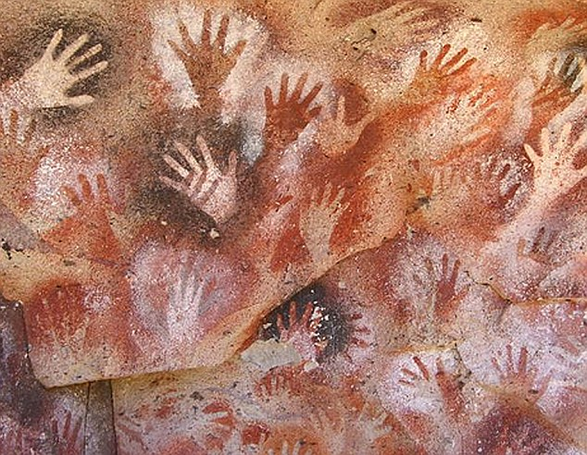
Cueva de las Manos in Santa Cruz, Argentina
13,000 to 9,000 years ago/ 11,000-7,000 BC
Notes:
Argentinian cave art produced 9-13 thousand years ago by individuals stencilling their hands onto cave walls. The prints left are both personal and anonymous.

Slide 28
Thank you :)
Notes:
Workshop ends.

Slide 29
These materials were developed by the Continuing Bonds: Creative Dissemination project
https://continuingbonds.live/creative-dissemination/

Slide 30
Workshop 2:Deepening Connection
Working with the dead…
Notes:
This workshop should take 1.5 - 2 hours to complete.

Slide 31
Timetable
10 mins Start
10 mins Welcome, Safety, Aims, Plan, Recap
5 mins What’s your story?
10 mins The politics of death, and difficult death
-Break-
20 mins Either reflect on materials from last time, work independently on your piece, or learn about writing/poetry theory
10 mins Sharing (writing, objects, personal experiences)
10 mins Close (and questionnaire)
Notes:
This workshop provides a re-cap on W1, encourages sharing of creative work and inspiration materials, and spends time looking at the politics of death. Individuals will have the opportunity to spend time re-engaging with the materials from last time, working independently on their piece, or learning about writing or poetry theory.
The timetable above gives suggested timings but you may wish to change these depending on the time you have available. In particular, we would encourage extending the amount of independent writing time given to individuals.

Slide 32
Welcome :)
Welcome newcomers and returners
Newcomers, please pick up a Sources of Support sheet and a Giving Helpful Feedback sheet
Everybody: Grab a brew!
Notes:
The workshops are designed as a set of three however it is possible for an individual to attend just workshop one or two (not workshop three) without attending the rest providing they are sent the slides from the other workshops.
Those new to the project at this second workshop will need to pick up a Sources of Support sheet and a Giving Helpful Feedback sheet.

Slide 33
Plan for today
Recap on last time
More writing time
More discussion time (about the materials and with each other)
Deepening connection with the materials
Introduction to some writing/poetry theory
Sharing your work and your experiences (if you like)
Buddying up for feedback (re-cap)
Art exercise
Notes:
This second workshop – Deepening Connection – will include more writing time, more discussion time about the objects and with each other, some sharing of attendees work and introduction to some writing/poetry theory.
Attendees will be invited again to ‘buddy up’ for feedback and to take part again in the art exercise.

Slide 34
Let's keep it safe
Workshop rather than a therapy group
'Rules'
Non-judgmental, supportive atmosphere
Confidentiality
Constructive feedback - what you liked, what you would like to see more of, framing points positively
    See ‘Giving Helpful Feedback’ in W1 pack
Looking after yourself
Sources of support in your pack
Take a break whenever you need
Allow yourself to 'hold back' if you need to
Notes:
Although the materials might spark personal thoughts or memories, the workshop (as is true for all three workshops) is not intended to be ‘therapy’. We would encourage participants to look after themselves in terms of allowing themselves to ‘hold back’ emotionally if this feels needed and to use the ‘sources of support’ given.
To create a safe space for attendees, facilitators can create ‘rules’ for the workshop. It is important the space is non-judgemental and supportive, that personal stories/experiences shared in the workshop are kept confidential, and that feedback on creative work is given positively. It can be helpful to frame feedback in terms of what individuals liked about someone’s work and what they would like to see more of. There is a handout on ‘Giving Helpful Feedback’ in the Guidance Notes.

Slide 35
Ultimate aims of the project
3 workshops (‘Inspiration’, ‘Deepening Connection’, ‘Editing/finalizing’)
Widening the boundaries on talking about death, dying, bereavement and grief
Notes:
The ultimate aim of the workshops are to widen the boundaries on talking about death, dying, bereavement and grief. This is to target the sense that talking about death is often felt ‘taboo’ in Western society which can lead to problems like individuals not writing wills or telling their loved ones what they would like for the funeral, to individuals not knowing what is ‘normal’ to experience when bereaved, and to individuals who are bereaved not feeling/being supported by those around them.

Slide 36
Recap on W1
Continuing bonds
      Throughout time and across the globe, we have kept the dead close
      Rather than ‘moving on’ we keep the memories and legacies of loved ones alive
          Through objects
      Death can be a tricky and political time
          Made worse when we do not talk about it
          What is ‘normal’? What do people want for their funeral?
          Accounts of death, dying, bereavement and grief
          Archaeological case materials and objects
          Free writing
Notes:
In workshop 1, individuals were introduced to the idea that throughout time and across the globe, individuals have kept the dead close. Rather than ‘moving on’, humans tend to keep the memories and legacies of loved ones alive, and often do this through objects. Workshop 1 touched on how death can be a tricky and political time, something which will explored further in this present workshop.
Attendees were shown contemporary accounts of death, dying, bereavement and grief, as well as archaeological materials and objects. Individuals spent time free-writing also.

Slide 37
What is your story?
Notes:
At the end of W1, individuals were asked (if they wanted to) to bring an object with them to this second workshop which was connected to their own legacy or that of a loved one.
Exercise. 5 minutes: What’s your story
This is a time for attendees to share objects or any other observations with the group. This can be kept to five minutes if individuals share in smaller groups.

Slide 38
Death can be a political time…
“A very good friend of mine died. Her family weren’t that bothered about her. [] Because they were the family they got to say where she got buried and she got buried in Ireland. [] The one time I went over [to Ireland, her grave] was just left to wrack and ruin. [] What it said to me was, ‘this is so wrong’. We would have taken care of her in Oxford. We would have gone to see her, gone to talk to her, gone to remember her. [] But her family had got the right to do what they wanted. [] The family often get the biggest say. [] Friends often don’t get any.”
“I nursed my friend through the end of her life. Her sisters [] wouldn’t listen to what she wanted. She knew she was dying because she had cancer. They told her to stop molly coddling about dying. After the biopsy [] she couldn’t leave the house and she deteriorated from there. [] They would never discuss anything with her. Everything that we discussed never happened at the funeral. Down to music. I think the only thing they requested was that everyone wore pink. They music she wanted wasn’t played.”
“I have a friend, almost four years to the day, who took her own life. To understand that, I knew I had to go and see the body. [] Immediately I thought, ‘that’s not you’. [] She was in a winceyette nightie. She was in her thirties and the most proud dresser. She had more shoes that I have seen in a shoe shop. [] This seemed a bit on an insult. I was thinking, ‘why didn’t you ask somebody who she was? A winceyette nightie? You’re kidding me’.”
“Possession of the ashes is sometimes a contentious family issue. Who has the ashes? Should ashes be in one place? One family [at work] was like, ‘can you divide the ashes so they are equally shared across the family’. [One person’s reaction was], ‘my God, you can't do that’. One body in life and one place in death.”
Notes:
Death can be a political time in which tensions run high and there seem to be no ‘rules’, or rules which clash with each other. At the heart of these issues is often a sense of respect (or disrespect) and the desire to do the ‘right’ thing by a person or in a particular situation.
This is exemplified in the quotes above.
Top left: This quote depicts how it was important to this individual that her friend’s grave was visited and cared for yet this wasn’t possible because she was buried close to her family in Ireland and far away from where her friends lived.
Bottom left: This quote depicts how it was important to the individual that she was buried in clothes which depicted her personality and how this (in her opinion) didn’t happen.
Top right: This quote depicts how it was important to the individual that her dying friend’s wishes were carried out at her funeral and how this (perceivably) didn’t happen because her sister’s ‘wouldn’t listen’ to what she wanted.
Bottom right: This quote depicts how families can differ about who has possession of a loved ones’ ashes and the acceptability of ashes being split between family members.
(We would suggest picking one or two of the quotes on this slide rather than reading all four).

Slide 39
Death can be, and often is, difficult...
Long-term care preceding death
Sudden and unexpected death
Untimely death
The injustice of death
“I have one son [who] will not talk [] about my death. My other son [will]. I keep saying to him, I am going to have to tell you [my wishes] because Freddie won’t listen.”
“I work in a care home. [We had a resident who] got told by the hospital she had two weeks [to live]. She had cancer. She started kicking off. She [was] 97 and didn’t want to go. Because of that she kept on and on and [was] trying to fight it. She had antibiotics and she said, ‘ah, will these make me better?’ It [was] more because she didn’t want to leave her family.”
Notes:
Due to medical advances we are living longer and experience longer-term care before death. This is what we often expect (and hope) for ourselves – a long life. Sudden and unexpected death can feel unjust and untimely.
Top right: This quote exemplifies how children may feel uncomfortable talking about their parents’ deaths. This has left the parent fearing their wishes (for their body and funeral) will not be heard, and by association carried out.
Bottom left: This quote exemplifies how individuals are sometimes not ready for death, even those who have lived what we perceive to be a long life.
Exercise [optional]: 5 mins
Open discussion with the group or see if people want to share their experiences

Slide 40
Break
Notes:
Now is a good time to take a break as after this, individuals will be split into groups to either do some writing, learn some writing theory, or work on their piece.

Slide 41
Exercise…
Options:
Spend some time with the material from last time
Work independently on your piece
Spend time learning about writing or poetry theory
Notes:
Exercise:
In the next part of the workshop, individuals can choose to spend some time reflecting on the materials they were introduced to in workshop 1, spend time working independently on their piece, or spend time learning about writing or poetry theory. We would advise splitting the room into different areas, each given over to one of these options.
We would advise giving at least 10 minutes for this exercise.
Note to writers: It is fine to write about life and not death, as death is often an inspiration for engaging with life.

Slide 42
Writing theory: Poetry (1)
‘Poetry holds out the promise that what has been experienced cannot disappear as if it had never been” John Berger – Once in a Poem
Use poetry to give voice to an experience that is uniquely yours
    Choose one or two of these tasks to try…
Task 1:
Think of an object, and remember or imagine the emotion that might be associated with it. Describe its material, patina, shape, weight and appearance. What is it about this object which best embodies the person or our relationship with them?
Task 2:
Think of a funeral, a memorial, or a rite that has happened - in the ancient past or in your own life. Did this help, comfort, and give shape to your grief, or not? What kind of 'send-off' or memories of the dead were made through these ceremonies?
Task 3:
Think of the place where the dead are laid or scattered: ancient or modern. Why here, and why is it meaningful? Are they alone or in company? Describe its atmosphere. What weather do you associate with it? What memories does it evoke?
Notes:
John Berger once wrote that poetry holds out the promise 'that what has been experienced cannot disappear as if it had never been' (in Once in a Poem - from 'And our faces, my heart, brief as photos' published by Bloomsbury Publishing 2005).
He encourages us to use our poetry to give voice to an experience that is uniquely ours. We each have very different attitudes towards losing someone, and dealing with the emotions and things they leave behind. We may feel paralysing physical grief, deep sadness, rupturing loss, anger, resentment, betrayal, regret or indifference. We may feel blessed or burdened. The following exercises are designed to help you either imagine what someone in the past might have felt when they placed something with the ancient dead (if you want to be inspired by the archaeology) or move you to thinking about your own experiences.
Task 1. Think of an object, and remember or imagine the emotion that might be associated with it. Describe its material, patina, shape, weight and appearance. What is it about this object which best embodies the person or our relationship with them?
Task 2. Think of a funeral, a memorial, or a rite that has happened - in the ancient past or in your own life. Did this help, comfort, and give shape to your grief, or not? What kind of 'send-off' or memories of the dead were made through these ceremonies?
Task 3. Think of the place where the dead are laid or scattered: ancient or modern. Why here, and why is it meaningful? Are they alone or in company? Describe its atmosphere. What weather do you associate with it? What memories does it evoke?

Slide 43
Writing theory: Poetry (2)
Elements to think about when creating your poem:
Voice:
Who is the speaker?
Is it you? Third person?
Imagery, symbolism and metaphor:
What images, symbols and metaphors might you use to help your reader make connection they might not otherwise?
Language:
Avoid weak and familiar words, and stereotypes.
What words might surprise or delight your reader?
Form:
What shape or structure do you want your poem to have?
Notes:
1. Voice - is there a speaker or narrator in your poem? Is it you, or in the third person, or is it more descriptive?
2. Form - think about what shape and structure you want your poem to have: it might be short couplets, verses, a longer poem or even 'prose poem'. Poetry gives you licence to experiment with this so be adventurous!
3. Poetry encourages you to experiment with strong imagery, symbolism and metaphor. You can help your reader make connections and meanings they might not otherwise expect, using these devices.
4. Language - avoid weak, familiar words and stereotypes: use a thesaurus to find alternative words to surprise or delight your reader.
5. The poem as a journey: how will you begin and where do you want to end up? Sometimes thinking of the last line helps you work out how to get there.

Slide 44
Writing theory: Short stories/flash fiction (1)
Common aspects to consider/look out for
1. Point of view.
    The perspective from which the story is told. E.g.
    1st person – “I went… I jumped… I felt…”
        - You can only tell the reader what your main character knows
        2nd person – “You went… You jumped… You felt…”
        - Rarely used. Makes the audience a character.
        3rd person – “Jane went… She jumped… She felt…”
            Three types (omniscient, limited, objective)
    https://www.youtube.com/watch?v=SKi56cPUSFk
Notes:
When writing prose such as short stories and flash fiction, there are some common aspects to consider or look out for; point of view, showing not telling, where to start, and use of setting.
Point of view
Point of view refers to the perspective from which the story is told. A first or third person perspective is common: i.e. ‘I went… I jumped… I felt…’ or ‘Jane went… Jane jumped… She felt…’. Second person perspective can be used but is rare. This is ‘You went… You jumped… You felt…’.
The point of view you choose impacts what you can write (the content) and what your character can know. In first person perspective, i.e. ‘I went…’, generally, you can only tell your reader what your main character knows.
In second person, i.e. ‘You went…’, you make your audience a character and have similar limitations to if you were writing in first person.
Third person, i.e. ‘Jane went…’, is more complicated because there are three types of third-person perspective: omniscient, limited, and objective. The youtube link connects to a video which describes each of these points of view in more detail.

Slide 45
Writing theory: Short stories/flash fiction (2)
2. Show not tell
      Writing comes alive when we show what is going on rather than telling
      This means we allow the reader to deduce what is happening rather than state it outright
      https://jerryjenkins.com/show-dont-tell/
Telling | Showing
Sara was cold. | Pulling her scarf up over her mouth, Sara shivered.
I was so angry. | My hands bunched into fists and a heat rose up my neck to my cheeks. “Are you alright?” Harry said. “You look like you’re about to blow.”
Notes:
Show not tell
It is common advice for writers to show not tell. Showing rather than telling brings our writing to life. When we show rather than tell the reader is left to deduce what is happening (which readers prefer) rather than stating it outright.
An example of telling would be, ‘Sara was cold’. We are telling the reader that Sara is cold rather than letting the reader see this for themselves. To show that Sara is cold, instead we could write, ‘Pulling her scarf up over her mouth, Sara shivered.’ This is written in third-person point of view.
Another example of telling would be, ‘I was so angry’. Again, we are telling the reader the narrator is angry rather than letting the reader see this. Instead, to show the reader the narrator is angry, we could write, ‘My hands bunched into fists and a heat rose up my neck to my cheeks. ‘Are you alright?’, Harry said. ‘You look like you’re about to blow’. This is written from the first person perspective and uses another literary device – dialogue - to show the narrator’s anger by what the character Harry says.

Slide 46
Writing theory: Short stories/flash fiction (3)
Starting with the character
      Writing: You can start with your story or your character. For some, writing is easier when you start with your character. (You know who they are and how they would react when things happen to them).
      Brief Exercise: Have you decided who your protagonist (main character) is?
          If not, pick two random letters of the alphabet. These are your character’s initials.
          Using your setting
                Setting can be helpful for depicting the mood of the scene. (Pathetic fallacy).
                Imagine: Wedding 1: On the morning of Jill and Peter’s wedding, the sun rose bright over lush green fields.
                Wedding 2: On the morning of Jill and Peter’s wedding, dark clouds covered the sky and thunder rumbled on the horizon.
Notes:
Start with the character
When starting to write a piece of prose, individuals will find themselves inspired in different ways. Some writers start with a story they want to tell. More commonly, a certain line or voice or image will come to a person and they will start thinking around this and develop an idea of a character. Developing a character first helps you write a story which feels genuine – you know what your character would or wouldn’t do and your story will be influenced by how they overcome the obstacles in their way.
Exercise [2 mins]:
To start developing a character pick two random letters of the alphabet. These are your character’s initials. Create a name for your character.
Use your setting
Setting is helpful for setting the mood of the scene. When we use the weather to mirror the mood – e.g. an argument happening in a heatwave – we call this pathetic fallacy. See how the mood of a wedding can be changed depending on how we write the weather:
“On the morning of Jill and Peter’s wedding, the sun rose bright over lush green fields.”
Vs
“On the morning of Jill and Peter’s wedding, dark clouds covered the sky and thunder rumbled on the horizon.”
Use your setting to create tension in your writing and to mirror the mood – have a couple whose marriage is rocky together in a malfunctioning lift, have a child meeting the person who will quickly become their best friend on a sunny day at a funfair.

Slide 47
Exercise: Sharing…
In groups, either:
    A. Share some of what you have written
    B. Tell the group about the object you have brought
    C. Freestyle! What has the workshop brought up for you…?
Notes:
Exercise [10 minutes]: The next part of the workshop involves sharing in a group. Individuals should already be split into groups from the previous exercise. The groups can either share some of what they have written in the workshop(s) or are thinking of writing, tell the group about the object they have brought, or ‘freestyle’ – sharing what the workshop has brought up for them.

Slide 48
Feedback buddies
Buddying up for feedback (optional)
    Pairs or small groups (Whatsapp? Facebook? Email?)
    Refer to feedback guidance (Giving Helpful Feedback)
    Aim to have a good draft by next workshop – will need something to work onon
Notes:
As discussed in workshop 1, to get feedback on their pieces, attendees are encouraged to find a ‘feedback buddy’ from the group. Pairs or small groups work best. Decide how you are going to contact each other and swap contact details.
Please make sure your feedback is kind and constructive – see Giving Helpful Feedback in your packs.
Please aim to have a good draft of your piece by the next workshop, which is called ‘Editing and Finalising’.

Slide 49
And before we end…
Bring a substantial draft of your piece for next time
    Please bring three copies of your work with you
Look after yourselves... use the sources of support if need be
Notes:
Between this workshop and the next attendees are advised to work on their pieces, to get feedback from others and to create a substantial draft for the final workshop.
Individuals will be sharing their pieces and getting feedback in the next workshop, Editing and Finalising. Please ask them to bring three copies of their work with them in anticipation of this.
Talking about death and dying can bring up thoughts and emotions which are difficult or unexpected. Remind attendees to look after themselves and to use sources of support if needed. The Sources of Support document developed for the Creative Dissemination workshops is available in the guidance material, see ‘Guidance Booklet’. Sources of support will need to be developed specifically for the geographical area workshops are being facilitated in. This should have been developed for your W1, Inspiration.

Slide 50
Thank you ☺

Slide 51
These materials were developed by the Continuing Bonds: Creative Dissemination project
https://continuingbonds.live/creative-dissemination/
Notes:
Workshop ends.

Slide 52
Workshop 3:Editing and Finalizing
Working with the dead…

Slide 53
Welcome :)
Timetable :
10 mins Grab a brew, settle in, safety
25 mins Feedback and editing
10 mins (Early) Break
35 mins Sharing your creative process and learning from others’
(7:45-8:10 – groups of 3; 8:10-8:20 – the wider group)
10 mins Where next? Art exercise
Notes:
The aim of Editing and Finalising is for individuals to spend time getting further feedback on their work and to learn from their peers about the creative process. We close again with the art exercise.

Slide 54
Let's keep it safe (recap)
Workshop rather than a therapy group
'Rules'
Non-judgmental, supportive atmosphere
Confidentiality
Constructive feedback - what you liked, what you would like to see more of, framing points positively
    See ‘Giving Helpful Feedback’
Looking after yourself
Sources of support
Take a break whenever you need
Allow yourself to 'hold back' if you need to
Notes:
Although the materials might spark personal thoughts or memories, the workshop (as is true for all three workshops) is not intended to be ‘therapy’. We would encourage participants to look after themselves in terms of allowing themselves to ‘hold back’ emotionally if this feels needed and to use the ‘Sources of Support’ available.
Sources of support will need to be developed specifically for the geographical area workshops are being facilitated in. This should have been developed for your W1, Inspiration.
To create a safe space for attendees, facilitators can create ‘rules’ for the workshop. It is important the space is non-judgemental and supportive, that personal stories/experiences shared in the workshop are kept confidential, and that feedback on creative work is given positively. It can be helpful to frame feedback in terms of what individuals liked about someone’s work and what they would like to see more of. There is a handout on ‘Giving Helpful Feedback’ in the Guidance Notes.

Slide 55
Exercise 1: Feedback and editing
In groups of 3
10 minutes each
  Read your piece
  Feedback from group members
        E.g. What strikes you most about the piece? What did you like in particular? What would you have liked to see more of?
        If you have made notes, please give them to the person whose piece they are about
Notes:
Exercise [25 minutes]:
Split individuals into groups of three.
If individuals brought spare copies of their work with them – now is the time to distribute them.
They will have ten minutes each to read their piece and get feedback from the group members. Please ask individuals to give critique kindly and positively. There is guidance on this (entitled Giving Helpful Feedback) in the Guidance Notes.
Individuals can give feedback about what strikes them most about the piece, what they liked in particular and what they would have like to have seen more of.
If individuals have made notes, please give them to the person whose piece they are about.

Slide 56
Break

Slide 57
Exercise 2a - Your Creative Process
Back in groups of 3
Explain to your group:
    How you created your piece (what was your creative process?)
5 mins each for the group to ask questions about the creative process and learn about this
Notes:
Exercise [25 minutes – 15 initially, 10 to share]:
This exercise is an opportunity for individuals to learn about how others’ become inspired and develop their pieces. It is an opportunity to learn about the creative process from one-another.
In groups of three, each individual should explain to their group how they created their piece, describing what their creative process was.
The group have five minutes to ask questions of the individual about their creative process and to learn about this.

Slide 58
Exercise 2b - Feed back to the wider group:
What did you learn?
What struck you from your discussion?
Notes:
Exercise [10 minutes]:
Ask one or two people from each group to feed back to the wider group about i) what they learned about writing/the creative process and ii) whether anything struck them from their discussion.

Slide 59
And before we end…
  Art exercise
Notes:
Here is a good opportunity for individuals to add their handprint to the art exercise offered in W1. This can be a nice way to round off this final workshop. See the next slide for the exercise instructions and information about the inspiration behind the exercise.

Slide 60
Cueva de las Manos in Santa Cruz, Argentina
13,000 to 9,000 years ago/ 11,000-7,000 BC
Notes:
Art exercise:
This exercise invites individuals to draw round their hands on a sheet and write within the shape i) something they are taking with them from the workshop, or ii) something they wish to leave behind.
(This sheet of handprints was then displayed at the Creative Dissemination celebration events, see ‘Guidance Booklet’ for details.)
This exercise was inspired by Argentinian cave art produced 9-13 thousand years ago by individuals stencilling their hands onto cave walls. The prints left are both personal and anonymous.

Slide 61
Thank you ☺

Slide 62
These materials were developed by the Continuing Bonds: Creative Dissemination project
https://continuingbonds.live/creative-dissemination/
Notes:
Workshop ends.

Slide 63
We’d love to hear from you ☺
If you have used these teaching materials to run workshops of your own, please do tell us about it by emailing us at:
continuing bonds@bradford.ac.uk

Slide 64




Keeping in touch
https://www.facebook.com/continuing.bonds.58 (Profile rather than a page on Facebook)
@CBondsStudy or https://twitter.com/CBondsStudy
@CreativeDissemination or https://www.instagram.com/creativedissemination/
Continuing Bonds or https://www.pinterest.co.uk/continuingbonds/
https://continuingbonds.live/
Or on our email address: continuingbonds@bradford.ac.uk.
LIVE
Notes:
These teaching slides were developed through the Continuing Bonds: Creative Dissemination project. During this project a Facebook group, and Twitter and Instagram accounts, were created. This allowed individuals to stay up to date with the project and to connect with each other.
Our accounts are included above, feel free to create and add your own.

Slide 65


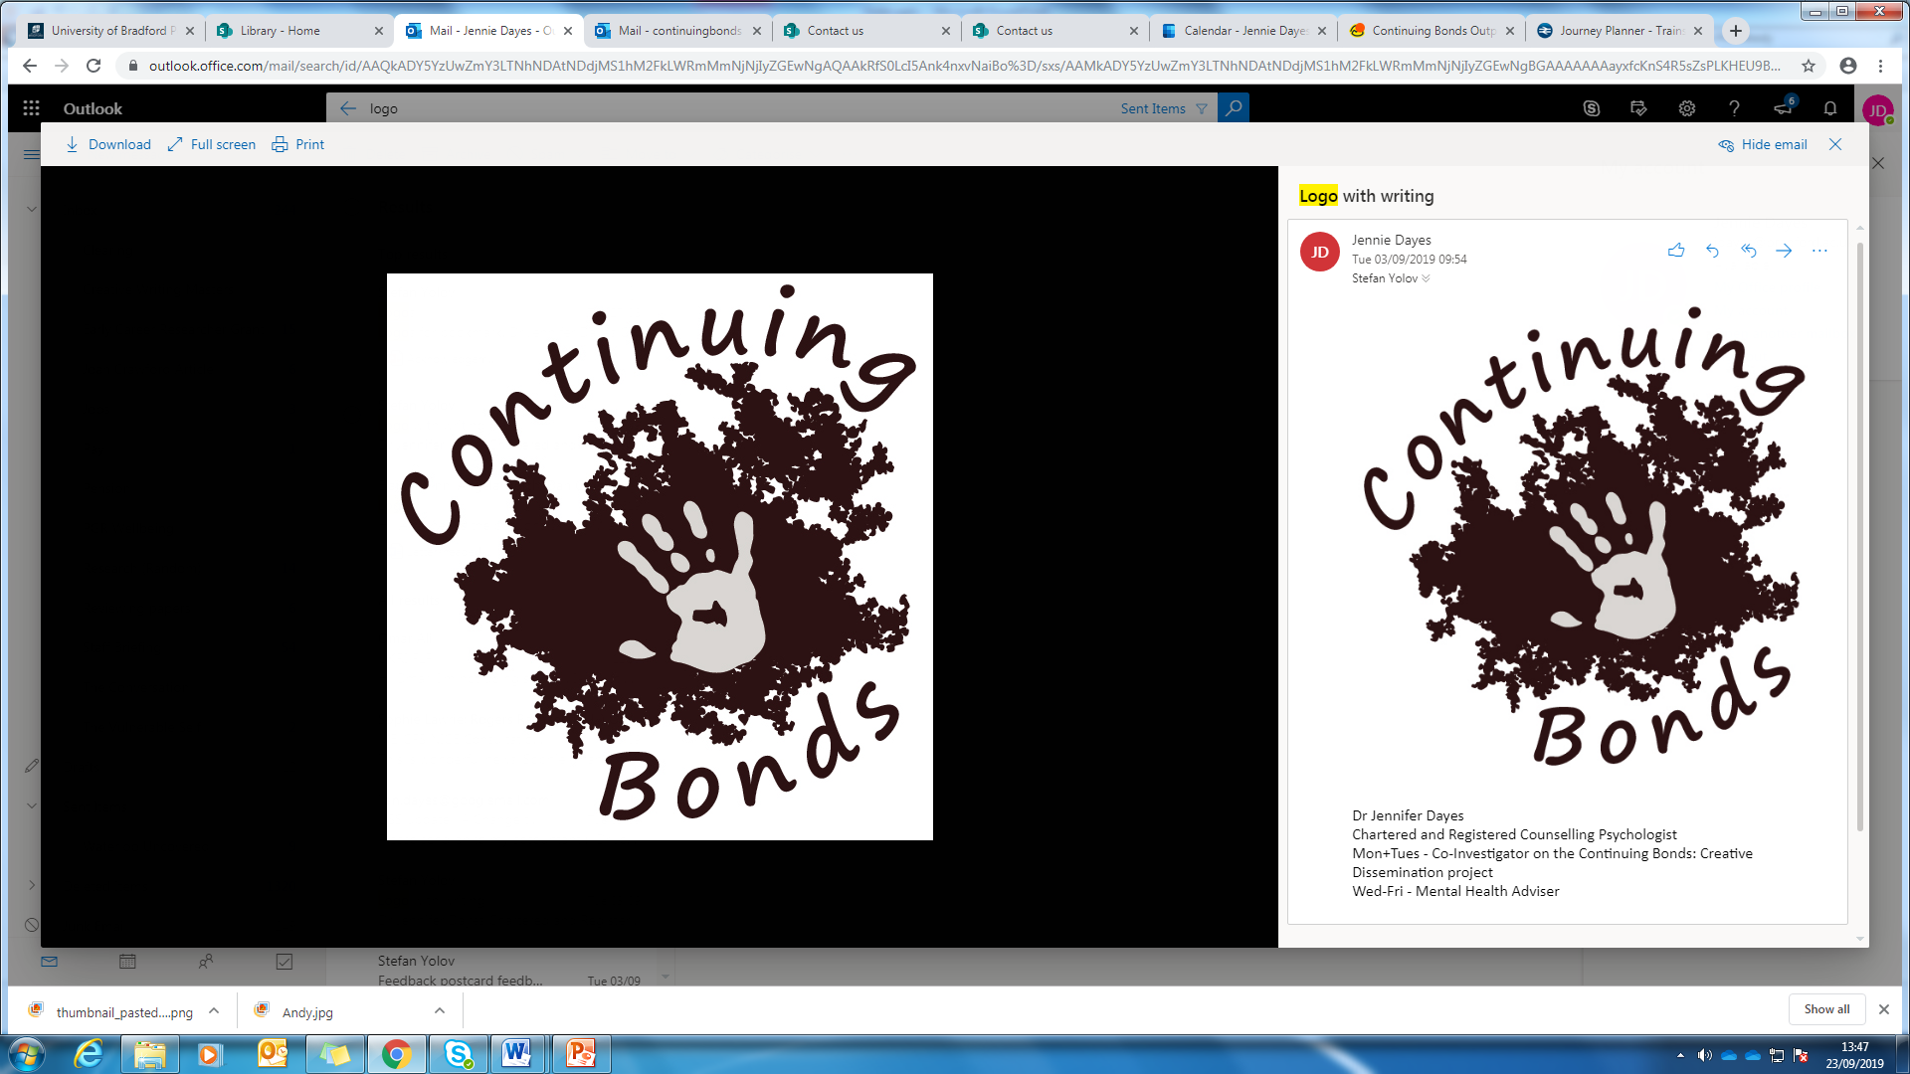




Acknowledgements

Slide 66
Sources
Case material | Source
Plastered Skulls image | Karina Croucher (courtesy Danielle Stordeur)
Hair Pin image | Melanie Giles (drawn by Agnes Mortimer, 1911)
Oil Burner image | Continuing Bonds: Creative Dissemination project, University of Bradford
Loom Weight image | Continuing Bonds: Creative Dissemination project, University of Bradford
Comb image | Continuing Bonds: Creative Dissemination project, University of Bradford
Amber Beads image | Continuing Bonds: Creative Dissemination project, University of Bradford
Roman Bracelet image | Continuing Bonds: Creative Dissemination project, University of Bradford
Grave Pottery image | Continuing Bonds: Creative Dissemination project, University of Bradford
Bead Necklace image | Continuing Bonds: Creative Dissemination project, University of Bradford
Image of Cueva de las Manos | https://en.wikipedia.org/wiki/Cueva_de_las_Manos#/media/File:SantaCruz-CuevaManos-P2210651b.jpg

Slide 67
Where to find out more:
Büster, L., Croucher, K., Dayes , J., Green, L. & Faull, C. (2018). From plastered skulls to palliative care: what the past can teach us about dealing with death. Online Journal In Public Archaeology. 8(2). http://revistas.jasarqueologia.es/index.php/APJournal/article/view/147
Croucher, K. (2012). Death and Dying in the Neolithic Near East. England: Oxford University Press.
Croucher, K. (2017). Keeping the dead close: grief and bereavement in the treatment of skulls from the Neolithic Middle East. Mortality. https://doi.org/10.1080/13576275.2017.1319347
Dayes, J. E., Faull, C., Büster, L., Green, L. & Croucher, K. (2019). Archaeology and modern reflections on death. BMJ Supportive and Palliative Care. 9(2). H
Williams. H. & Giles, M. ed. (2016). Archaeologists and the Dead. England: Oxford University Press.
ttps://spcare.bmj.com/content/9/2/229
Williams, H., Wills-Eve, B. & Osborne, J. ed. (2019). The Public Archaeology of Death. Sheffield, England: Equinox Publishing Ltd.
Notes:
Here are some references for more information should individuals be interested.

