Slide 1

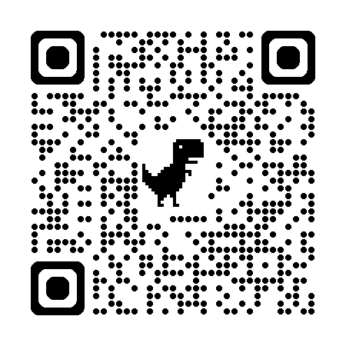
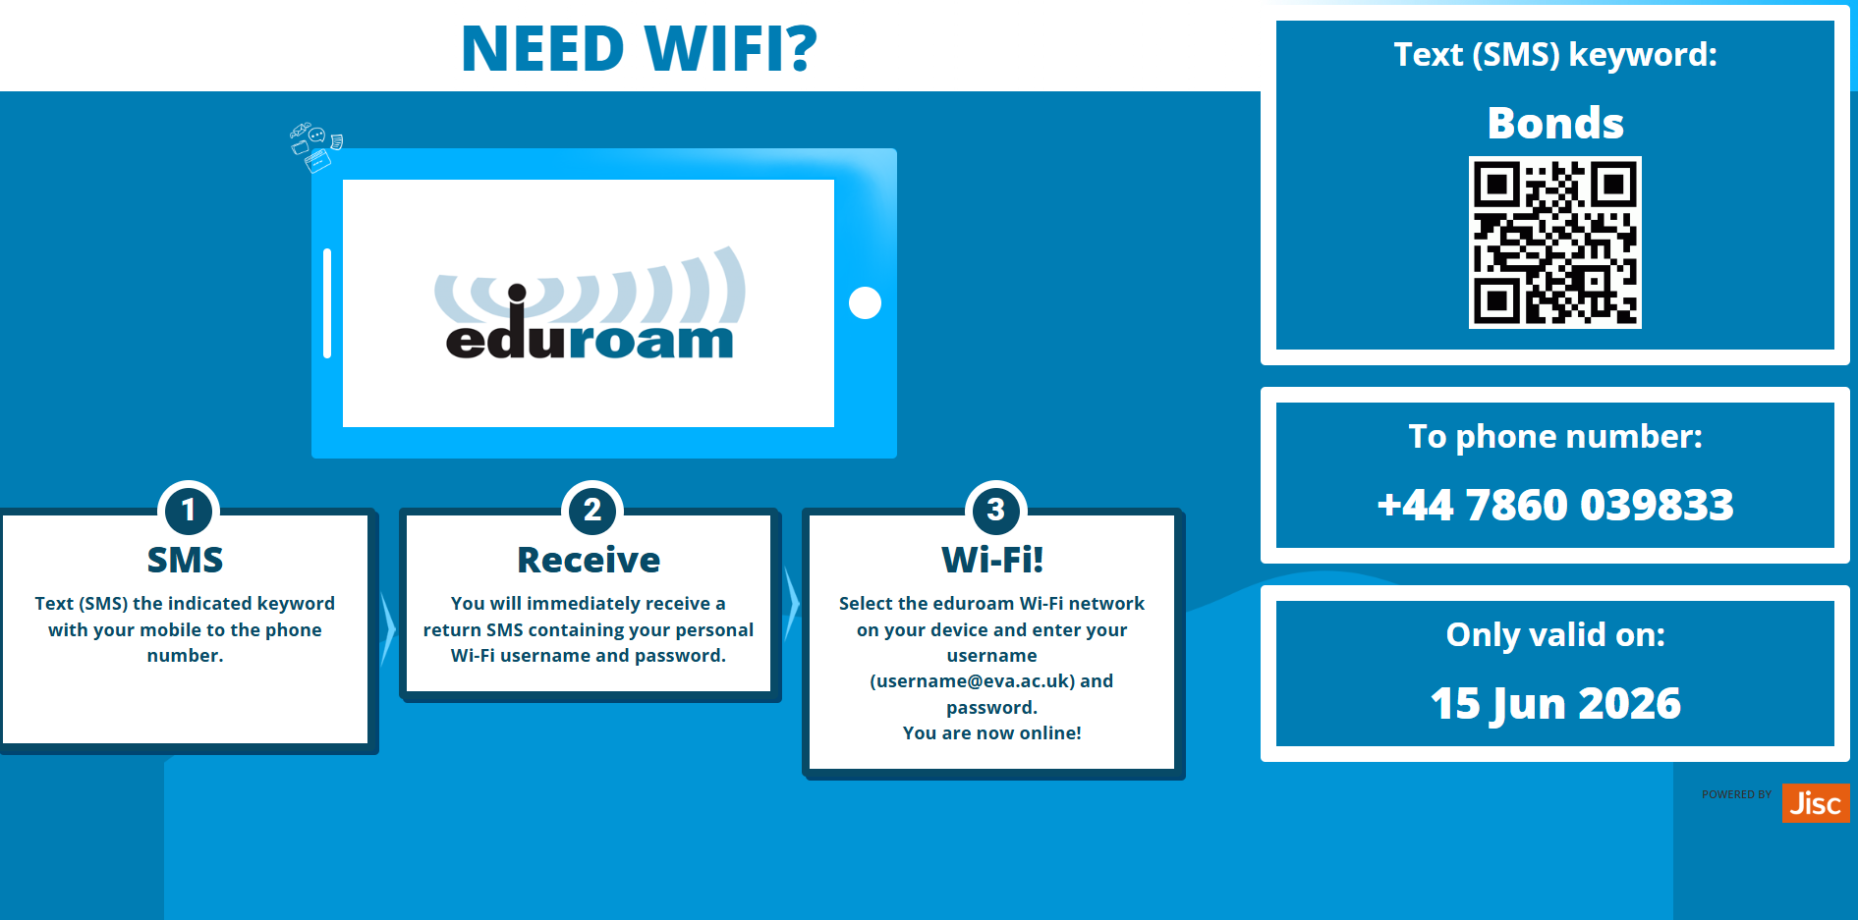
Let's Take a Look at the Toolkit……..
Use the QR codes below to log in to Continuing Bonds Toolkit and WIFI!

Slide 2

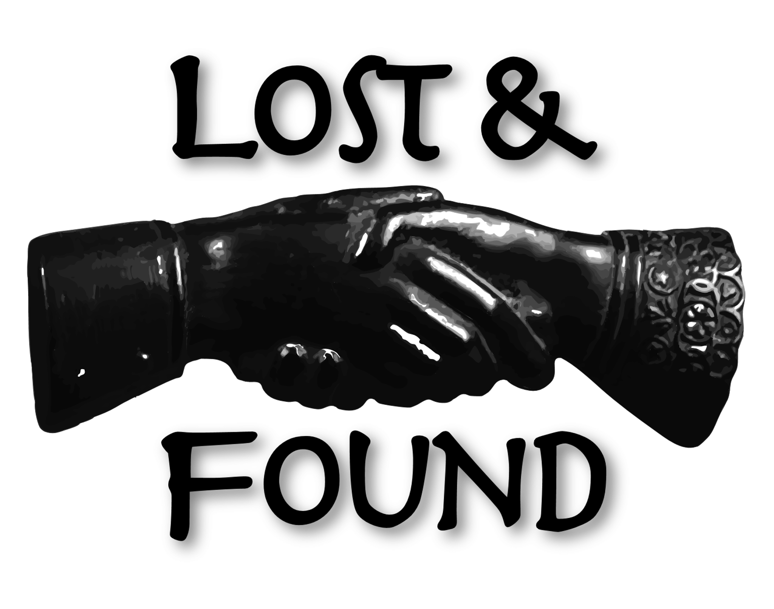
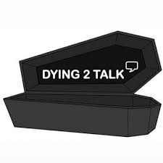
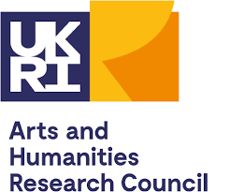

The Continuing Bonds Toolkit
Launch Event 15th June 2026
Prof Karina Croucher
Dr Eleanor Bryant
Dr Aoife Sutton-Butler

Slide 3
Today’s Launch
Background – Continuing Bonds
Initial development of toolkit
Collaboration with grief professionals
Taking a look at the resource
Case study examples
Workshop Training
There will be images of human remains
The topic matter deals with death and dying, potentially sensitive topics
Notes:
KC

Slide 4
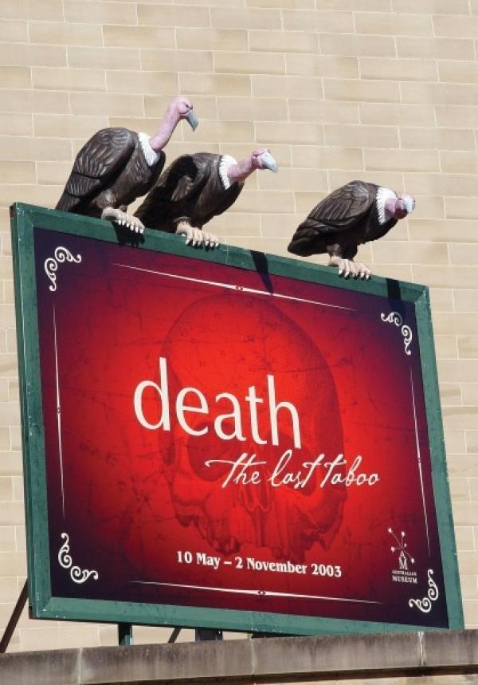
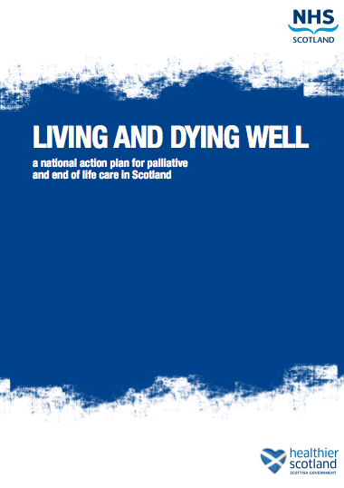
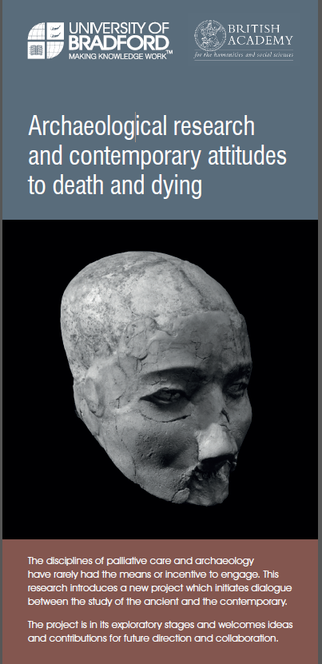
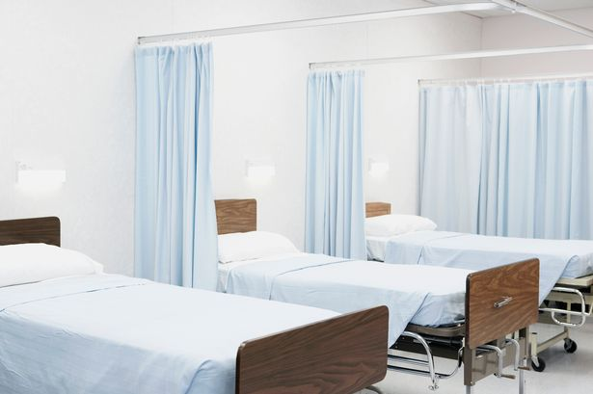
Continuing Bonds: Rationale
More people are aware of their deaths – fewer sudden deaths - yet still ‘taboo’ topic for many
Need to accept death as natural part of life course
Talking about death can enable ‘better deaths’ and aid family and patient
Can archaeology help facilitate conversation and break down taboos?
Notes:
KC

Slide 5


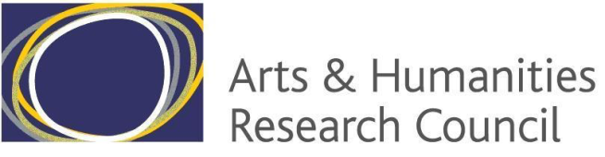
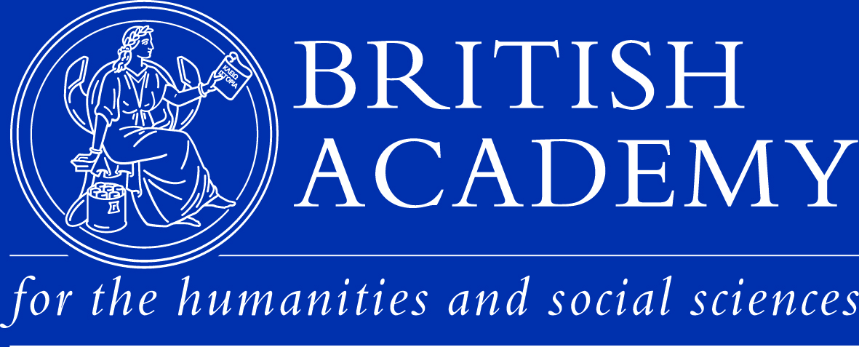
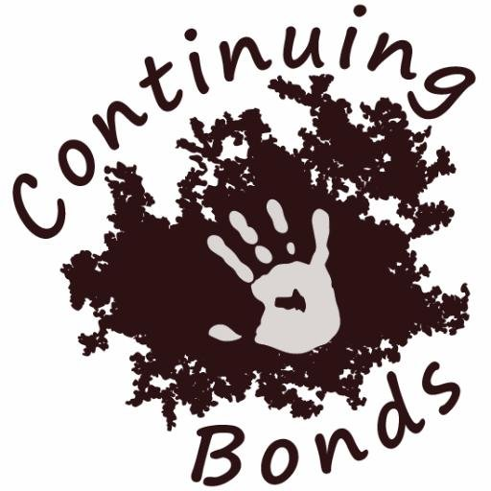
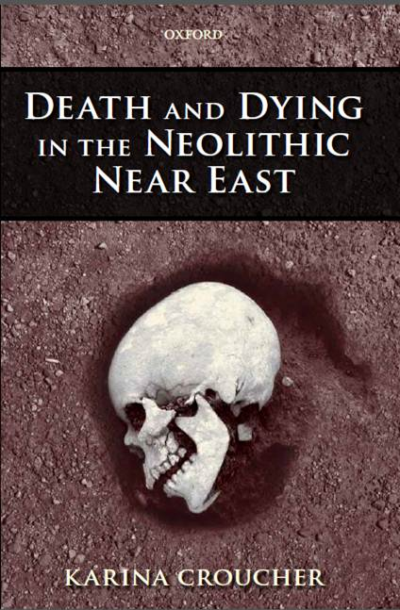
Continuing Bonds – Past and Present
Interdisciplinary research
Karina Croucher
Haaroon Ahmed, Jane Booth, Milly Booth, Lynsey Brown, Eleanor Bryant, Laurie Bryant, Laurie Bryant, Lindsey Büster, Nicola Clarke, Mia Coe, Lou Comerford Boyes, Jennifer Dayes, Aiden Duday, Christina Faull, Scott Feather, Melanie Giles, Ana Jara Gonzalez, Laura Green, Katie Jones, Harry Kingham, Jenny Laskowsky, Caroline Lloyd, Becky Moore, Nicola Murray, Philip Parr, Justine Raynsford, Sharon Snaylam, Paul Sullivan, Aoife Sutton-Butler, Martin Truelove, Elizabeth Walters and Stef Yolov
@CBondsStudy
#continuingbonds
Continuingbonds.live
Notes:
KC

Slide 6
Continuing Bonds – Past and Present
Interdisciplinary research
Karina Croucher
Haaroon Ahmed, Jane Booth, Milly Booth, Lynsey Brown, Eleanor Bryant, Laurie Bryant, Lindsey Büster, Nicola Clarke, Mia Coe, Lou Comerford Boyes, Jennifer Dayes, Aiden Duday, Christina Faull, Scott Feather, Melanie Giles, Ana Jara Gonzalez, Laura Green, Katie Jones, Harry Kingham, Jenny Laskowsky, Caroline Lloyd, Becky Moore, Nicola Murray, Philip Parr, Justine Raynsford, Sharon Snaylam, Paul Sullivan, Aoife Sutton-Butler, Martin Truelove, Elizabeth Walters and Stef Yolov
@CBondsStudy
#continuingbonds
Continuingbonds.live
Notes:
KC

Slide 7
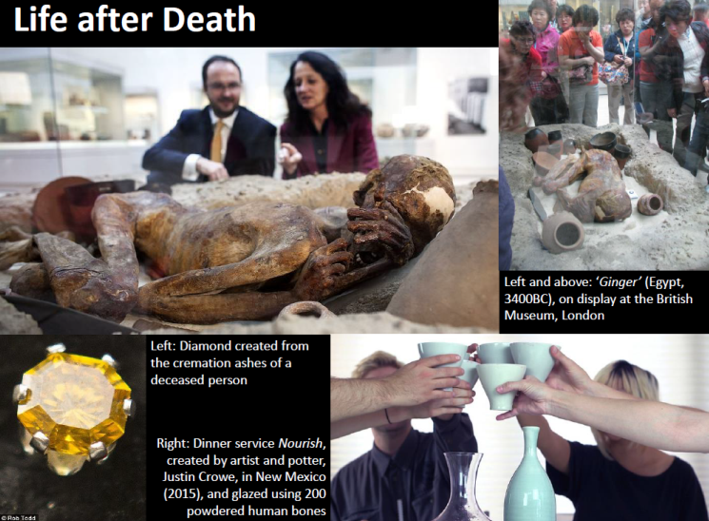
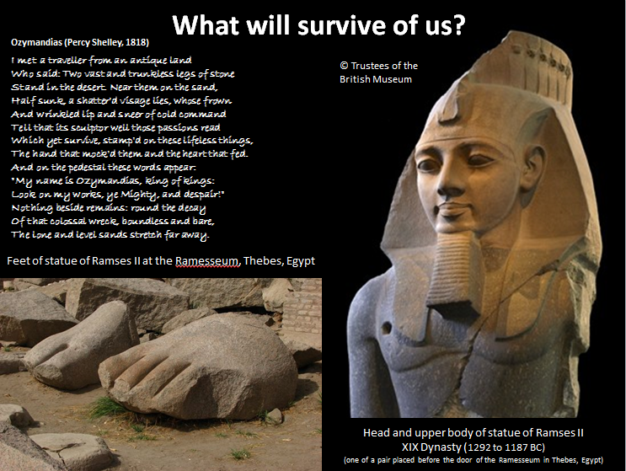
What we did:
Continuing Bonds: Exploring the meaning and legacy of death through past and contemporary practice
What impact (if any) does the use of archaeological case studies have on discussions of death, dying and bereavement in the present?
What are the impacts (if any) of cross-disciplinary collaboration between archaeologists and health care professionals?
Series of workshops with health/social care professionals and students, using archaeological case studies
Bradford and Leicester 2016-2018
Notes:
KC

Slide 8
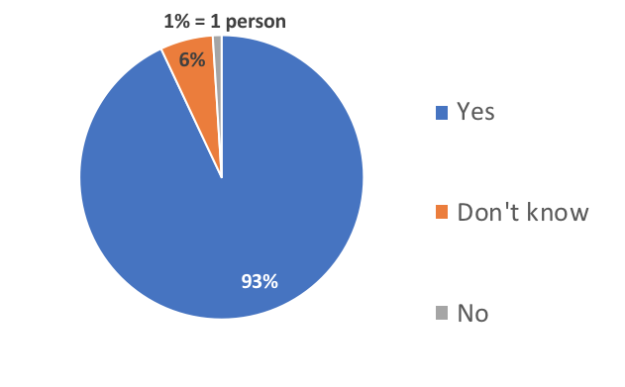
Key Findings
“In your opinion, do you think archaeological materials can be used to facilitate discussions about death, dying, bereavement and loss, or training in this area” (N=149)
“The workshop made me think about death, dying and bereavement in different ways.” 83% agreed/strongly agreed
    The most commonly selected words to describe the workshops have been ‘interesting’ (95%) and ‘thought-provoking’ (98%)
    Croucher et al 2020 ‘Archaeology and contemporary death: Using the past to provoke, challenge and engage’, PLoS ONE 15(12): e0244058. https://doi.org/10.1371/journal.pone.0244058
Notes:
CF

Slide 9
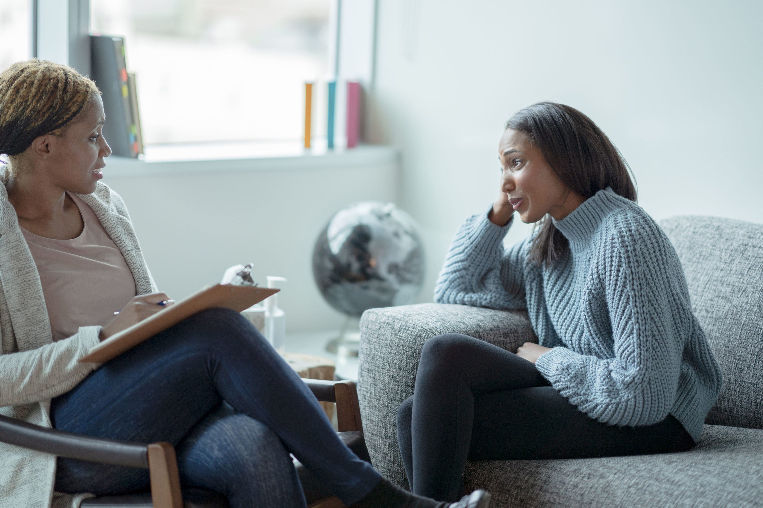
Using Continuing Bonds with different audiences: rationale
Cruse Bereavement Care – Skipton, requested CB workshops
Session at the Division of Counselling Psychology Conference
Need for developing a resource
Notes:
KC

Slide 10
Toolkit development: Interdisciplinary collaboration
Bereavement professional
Academic
Service user
Toolkit
Archaeology
Psychology
Web developer
Notes:
EB

Slide 11
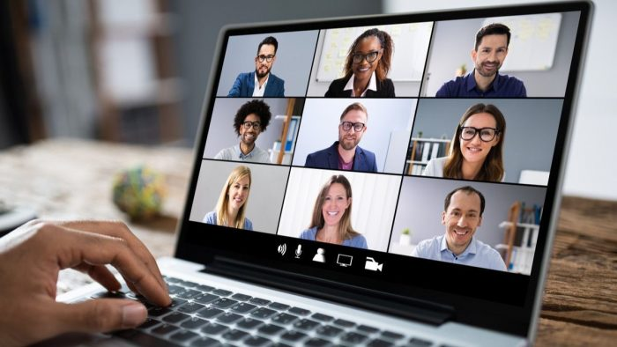
Toolkit development: Media used
Hadn’t intended an online resource, had planned workshop – COVID happened
Used expertise to create inclusive and interactive online tool
Case studies from CB project, with new materials
Developed online through online meetings and workshops
Virtual CPD workshops to explore concept
Notes:
EB

Slide 12
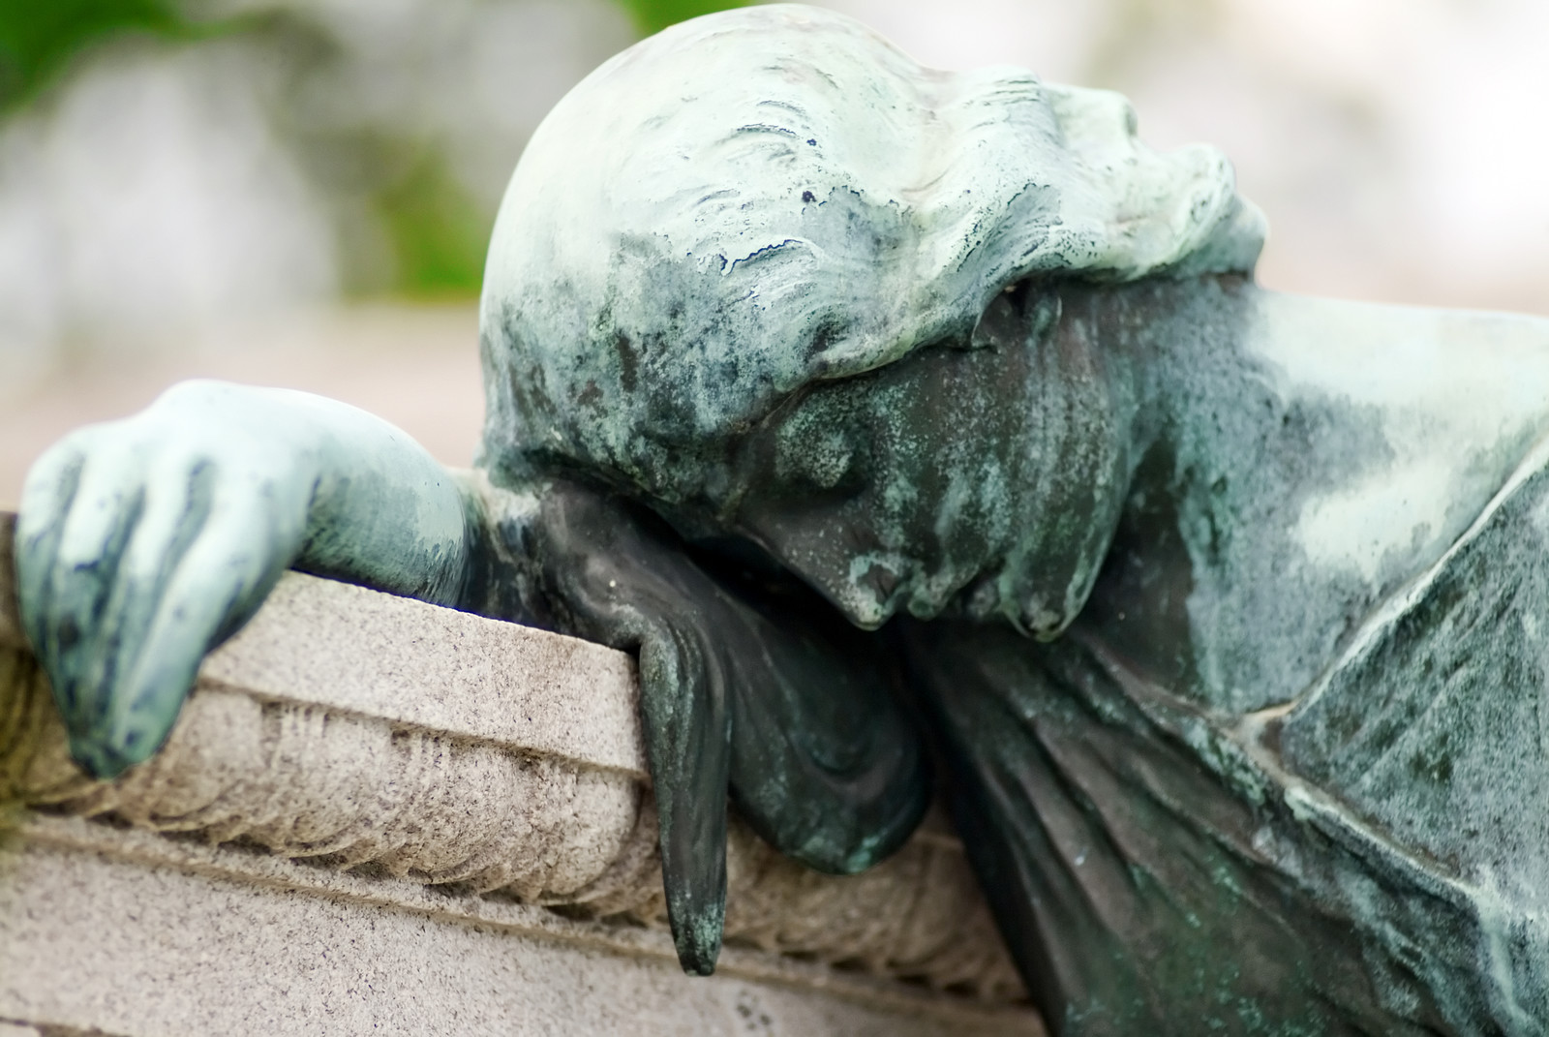
Toolkit development: Who is it for?
For use by professionals and / or individuals
Modules examining different ‘types’ of bereavement (critically)
  Intuitive vs Instrumental grief
  Dual Process Model
  Tasking of Mourning
  Continuing Bonds
  Anticipated Grief
‘Think abouts’ to explore individual grief
Acknowledging grief is an individual process – there isn’t a ‘right way’
‘Moving forwards’ – optional activities to engage in exploration of personal circumstances
Notes:
EB

Slide 13
Let's Take a Look at the Toolkit……..
Use the QR codes below to log in to Continuing Bonds Toolkit and WIFI!

Slide 14
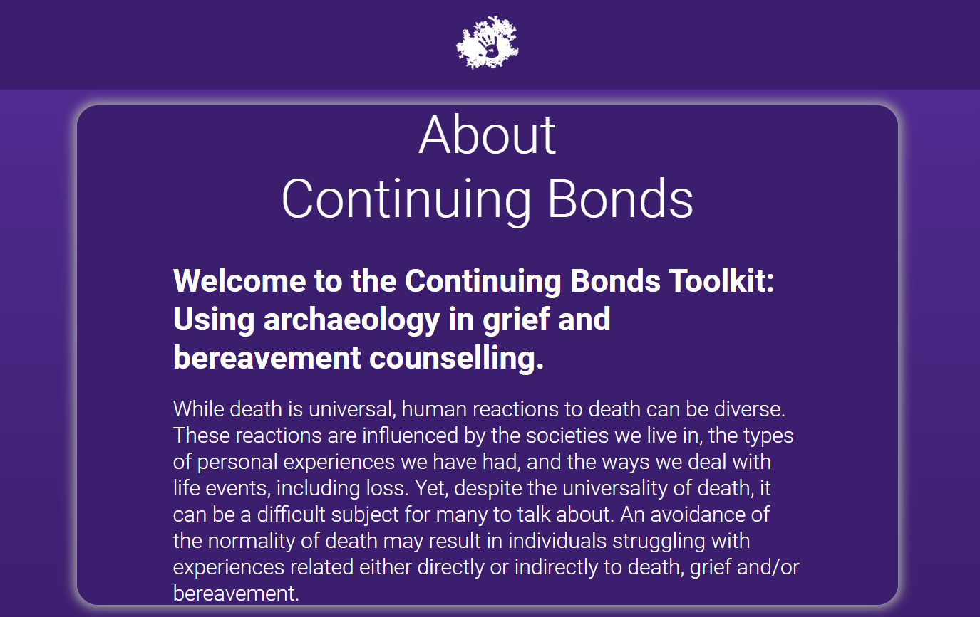

Slide 15
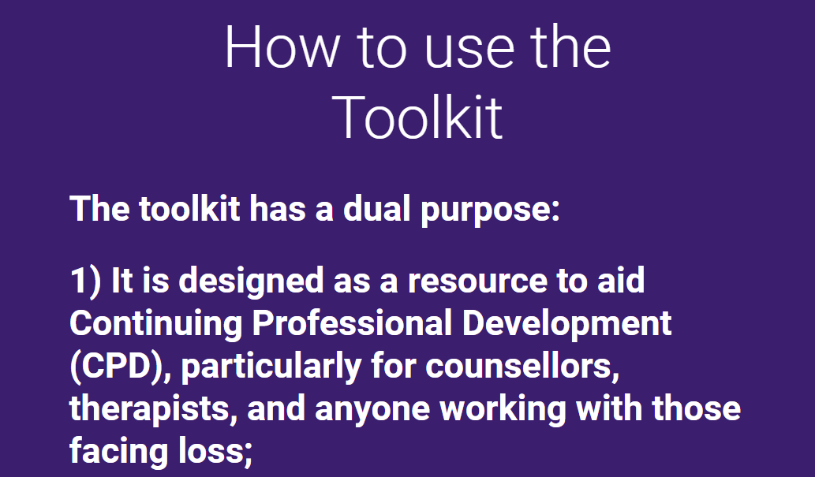
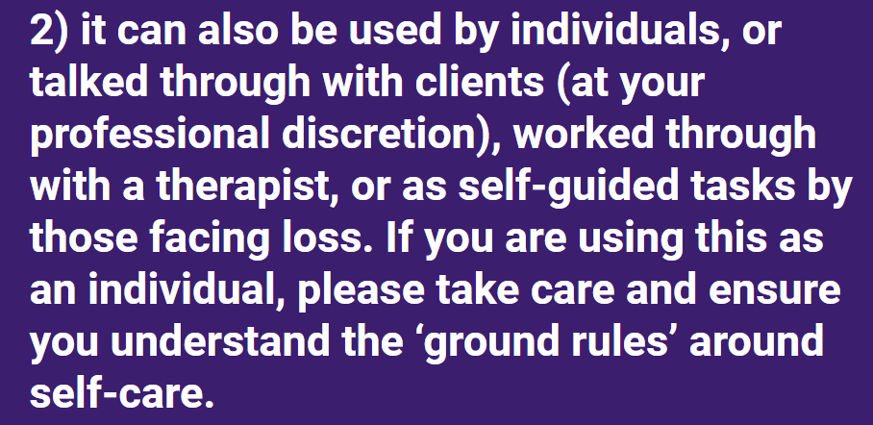

Slide 16

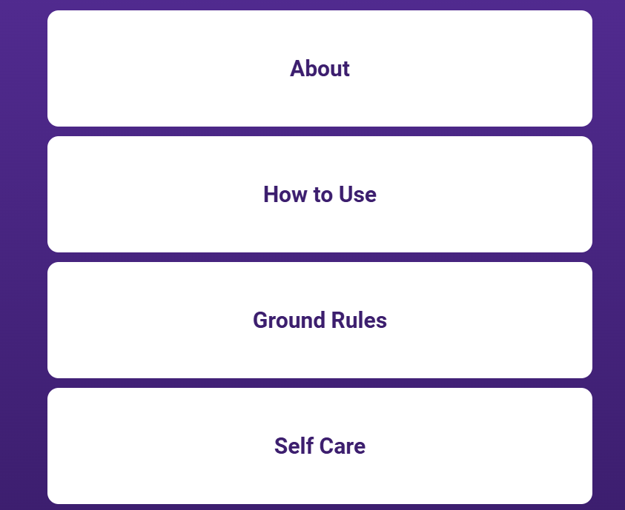
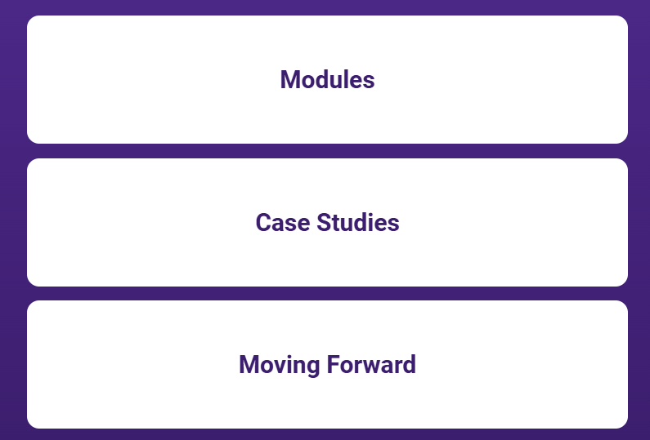
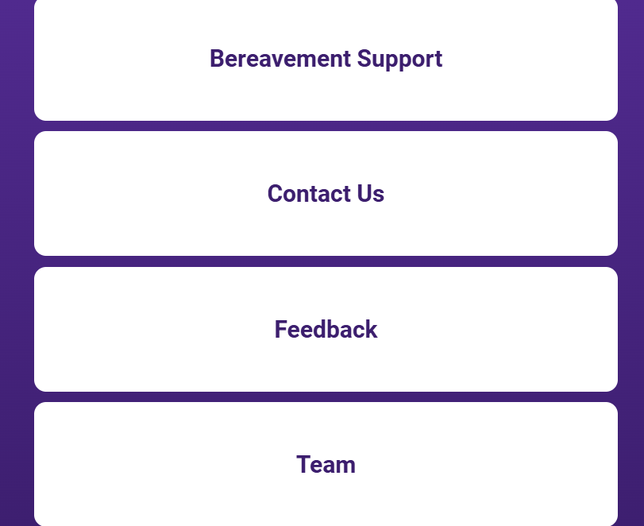
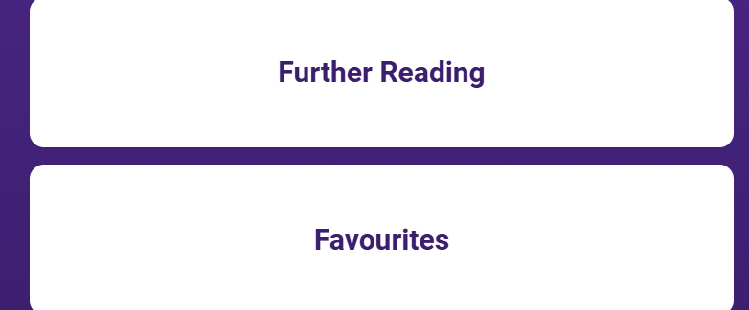
Initial menu -
Then click the 3-line menu to open more options

Slide 17
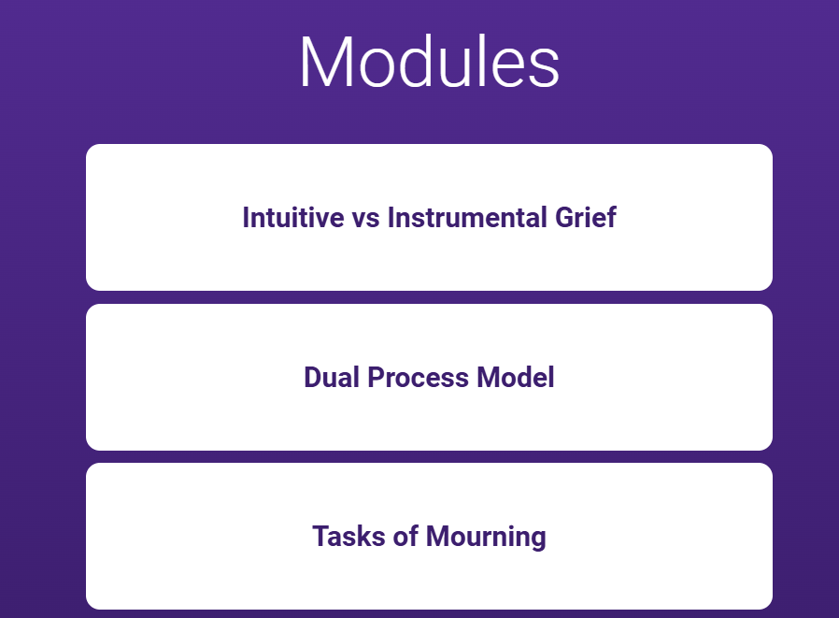
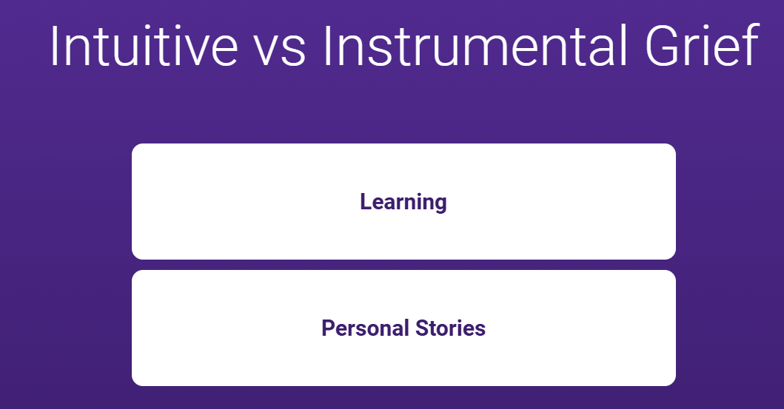

Slide 18
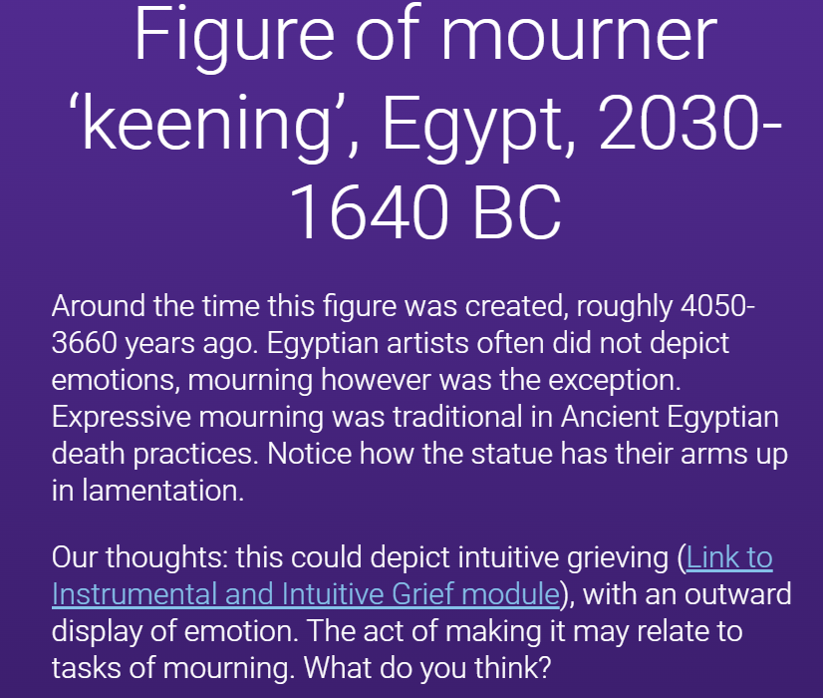
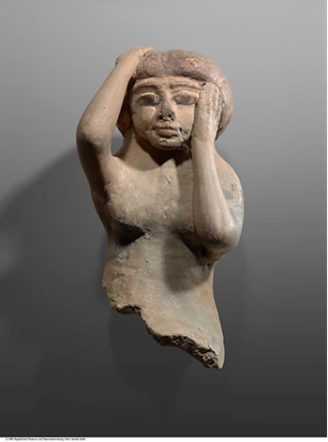
37 case studies altogether

Slide 19
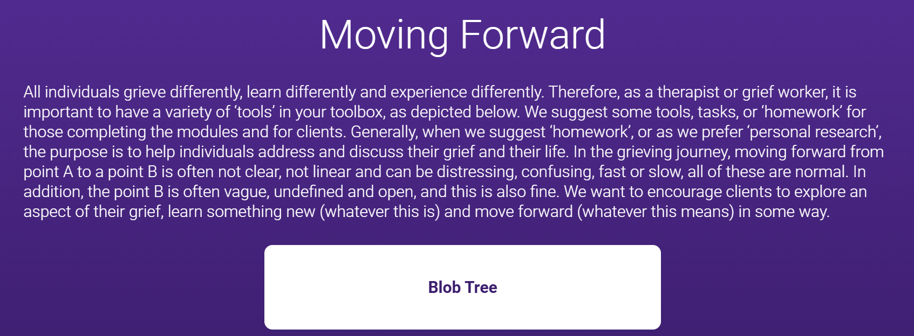
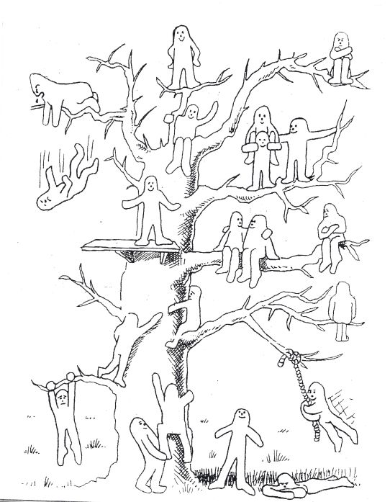
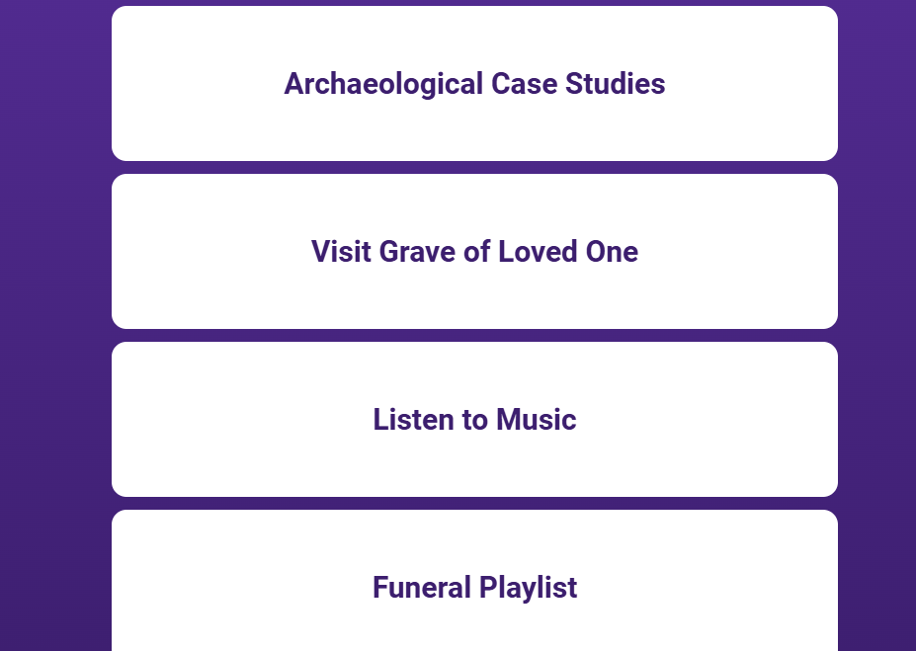
Tasks for helping to deal with loss and become more open in discussing death

Slide 20
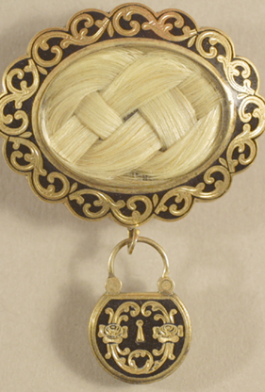
Mourning Brooch containing human hair, c.1848.
Brooch and locket inscribed: initials of H.G. Otis and G.H. Otis who both died in Oct 1848.
This brooch commemorates the death of Harrison Gray Otis (AD 1765 – 1848), and his grandson, George Harrison Otis (1836 – 1848) who died four days before his grandfather at the age of twelve. It is common for a single piece of mourning jewellery to commemorate the deaths of two or more individuals.

Slide 21
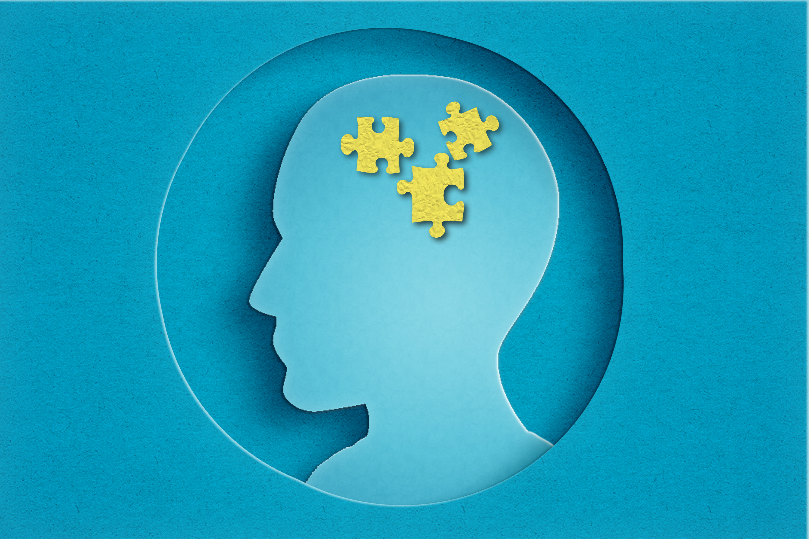
Our thoughts
Accepting the reality of the loss.
Dual Process Model- The mourner could confront and avoid the loss when they felt like - i.e. removing or wearing the brooch.
Continuing Bonds – a continued link to the deceased.
Links to modern day mourning jewellery i.e. cremation rings etc. Was fashionable in Victorian times.

Slide 22
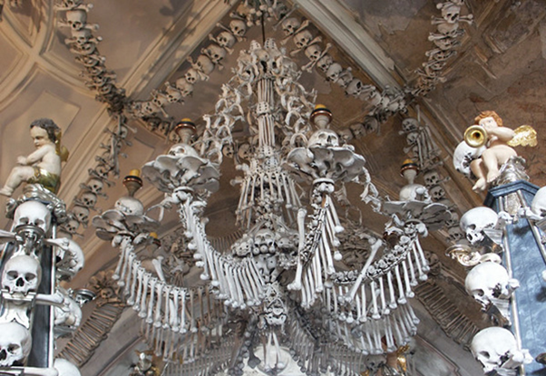
Capela dos Ossos (Chapel of Bones) in Évora, Portugal
The Capela dos Ossos in Évora, Portugal, was built in the 16th century by Franciscan monks. In the Counter-Reformation spirit of that era, the monks wanted to encourage their fellow brothers into contemplation and transmit the message of life being transitory.
By the 16th century, there were as many as 43 cemeteries in and around Évora that were taking up valuable land. Not wanting to condemn the souls of the people buried there, the monks decided to build the Capela dos Ossos and relocate the bones there. Around 5000 skeletons are thought to be displayed in the Capela.

Slide 23
Our Thoughts
Instrumental Grieving – grieving in their own way, problem solving solution and practical display of the dead.
Tasks of Mourning- Accepting a new reality.
Continuing Bonds- A continued link with their ancestors.
Links to display of photographs, gravestones, cremation urns etc.

Slide 24
How have we found the material beneficial?
Expanding our understanding of the self to include the deceased.
The creative community, emotional spirit.
Understanding of how traditions of the past can be used to understand the present.
Questioning the concept of ‘normal’ when discussing funerary rites.
Archaeology has made me consider elements of death, dying and bereavement which I had not considered before
Better able to identify these themes and work with them in the therapy room.

Slide 25
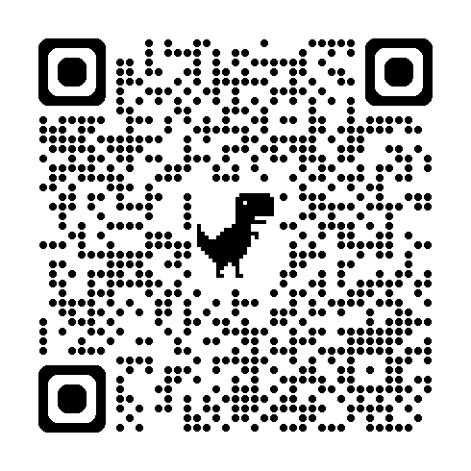
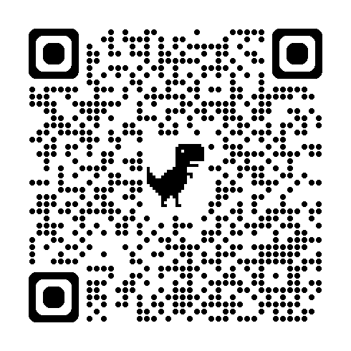
Join us for Training Workshops CPD
When? Monday the of 22nd June
Time: Two times available – 12pm and 5:30pm
Where: Online - Sign up using the QR codes below
12pm Session
5:30pm Session

Slide 26
Thank you for joining us
We would like to take a moment to thank you for joining us today for our Launch.
Take care of yourselves – sources of support:
  Cruse: The national charity for bereaved people in England, Wales and Northern Ireland. Helpline: 0808 808 1677. Web address: www.cruse.org.uk. Email for general inquiries: info@cruse.org.uk
  The Loss Foundation: A UK charity that provides bereavement support for those who have lost a loved one to cancer. Helpline: 0300 200 4112. Web address: www.thelossfoundation.org. Email for general inquiries: info@thelossfoundation.org

